Slide 1
[Instruction Slide – Delete Prior to Presenting]
NYSERDA has developed training material on Cold Climate Air Source Heat Pump Sizing and Design that is available for use in your training programs.
While some speaker notes are provided in the presentation, NYSERDA expects that trainers using this material would have significant knowledge of residential heat pump technology and applications to deliver the training effectively. Additional content, such as quizzes, recall moments, group activities and/or demos, is recommended to accompany this content as part of a comprehensive training.
The slides use basic, non-branded formatting to allow for the insertion of logos and/or other organizational themes and branding. You can apply themes or formatting to the Slide Master view for customization.

Slide 2
Cold Climate Air Source Heat Pump Sizing and Design Training
Orientation for:
Heat pump contractors' sales and admin staff
Utility program implementers
Regulators
Less experienced and alternative contractors
Other stakeholders
Notes:
Speaker: Welcome to… for heat pump contractors' sales and admin staff, utilities, and likeminded stakeholders

Slide 3
Goals of the Training
To obtain a foundational understanding of the following:
Variable capacity air source heat pump (VCHP) operations
Load calculations and why they matter
Sizing and selection methods
System design options and considerations
Control strategies and thermostat options
Design best-practices and recommendations

Slide 4
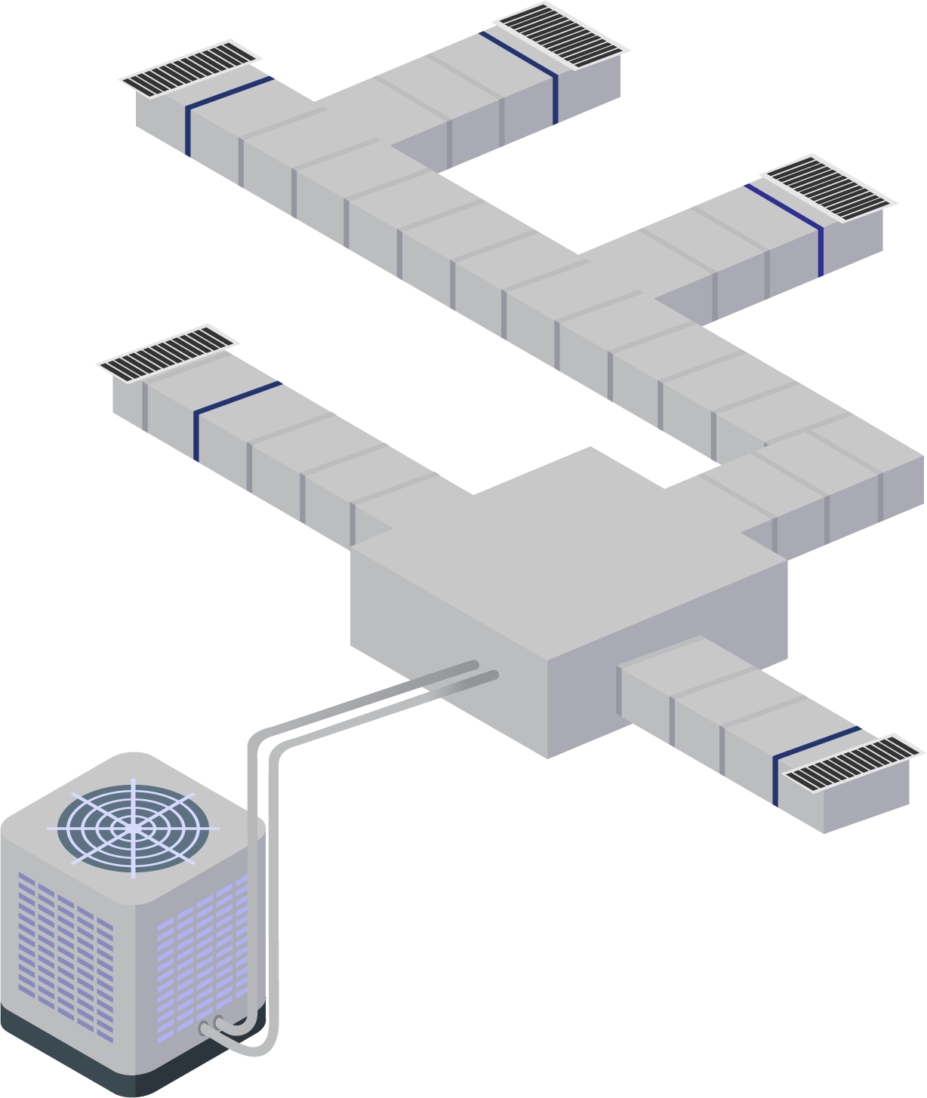
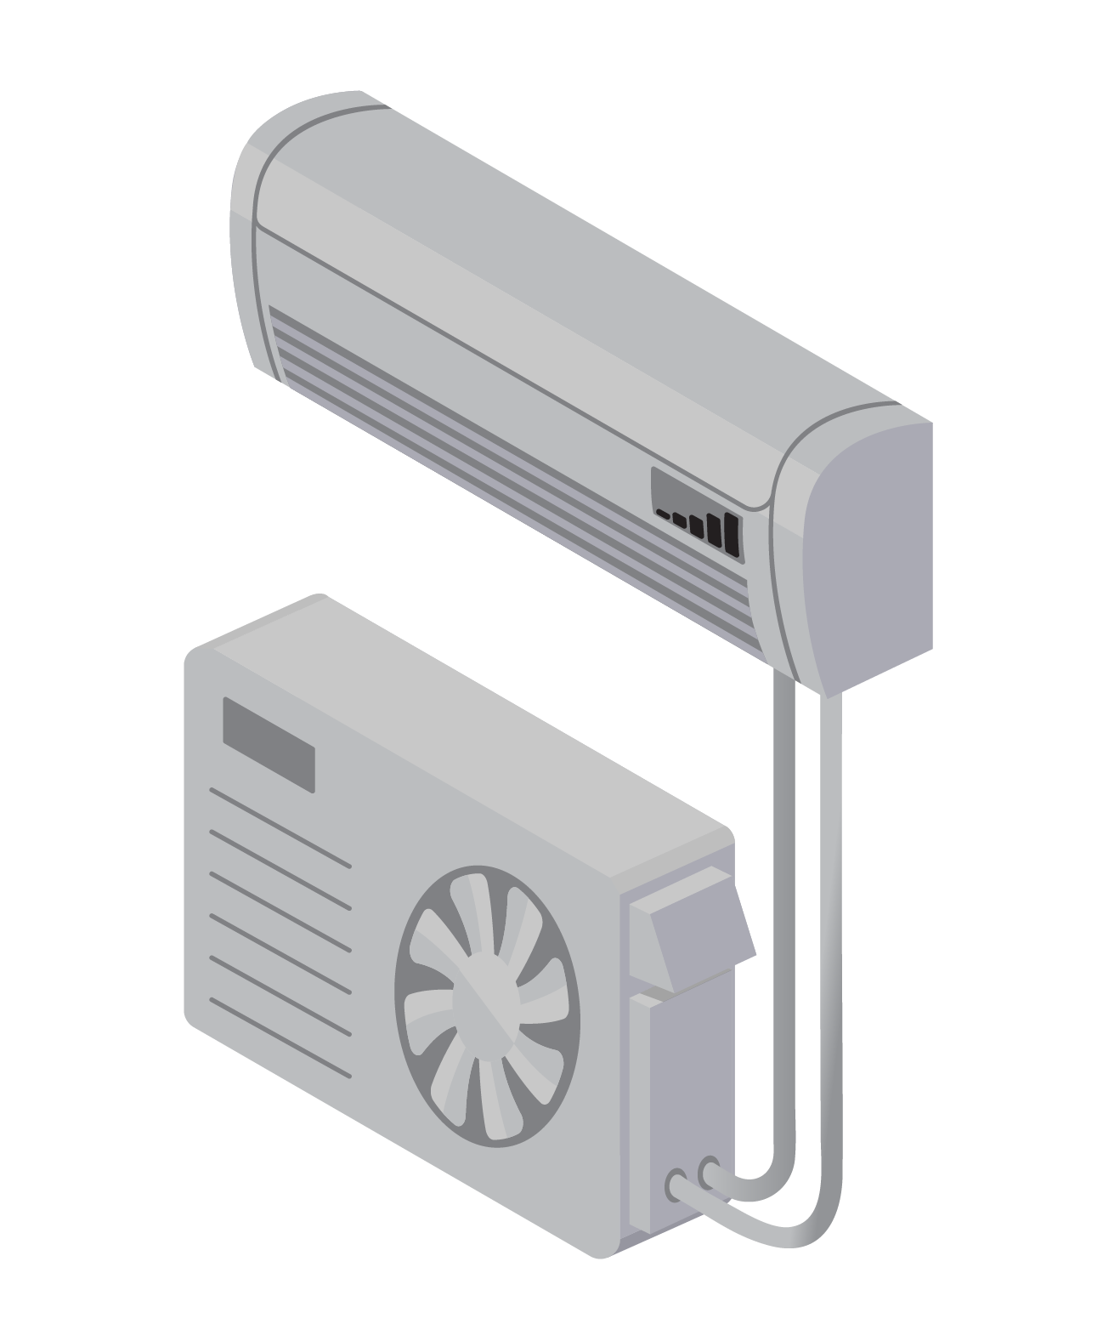
Part 1 Basic Principles of Heat Pump Operations

Slide 5
Heat Pump Basics Learning Outcomes
Understand the basic operation of a heat pump
Learn what defines a cold climate air source heat pump
Understand the advantages of variable capacity
Notes:
Discuss why this is important to the audience. Cater to the specific audience’s roll and pre-knowledge by asking questions about familiarity with HP installs (i.e., Possibly characterize as a refresher, or review, so as not to insult the audience by presenting too basic of information).
Homeowner’s perspective
Contractor’s perspective
Heat pump technology has improved over the last 15 years. New heat pumps are more capable of being the primary or sole heating source in cold climates. Understanding how they function can improve sizing and design decisions, as well as to add confidence in using them for primary heating.

Slide 6
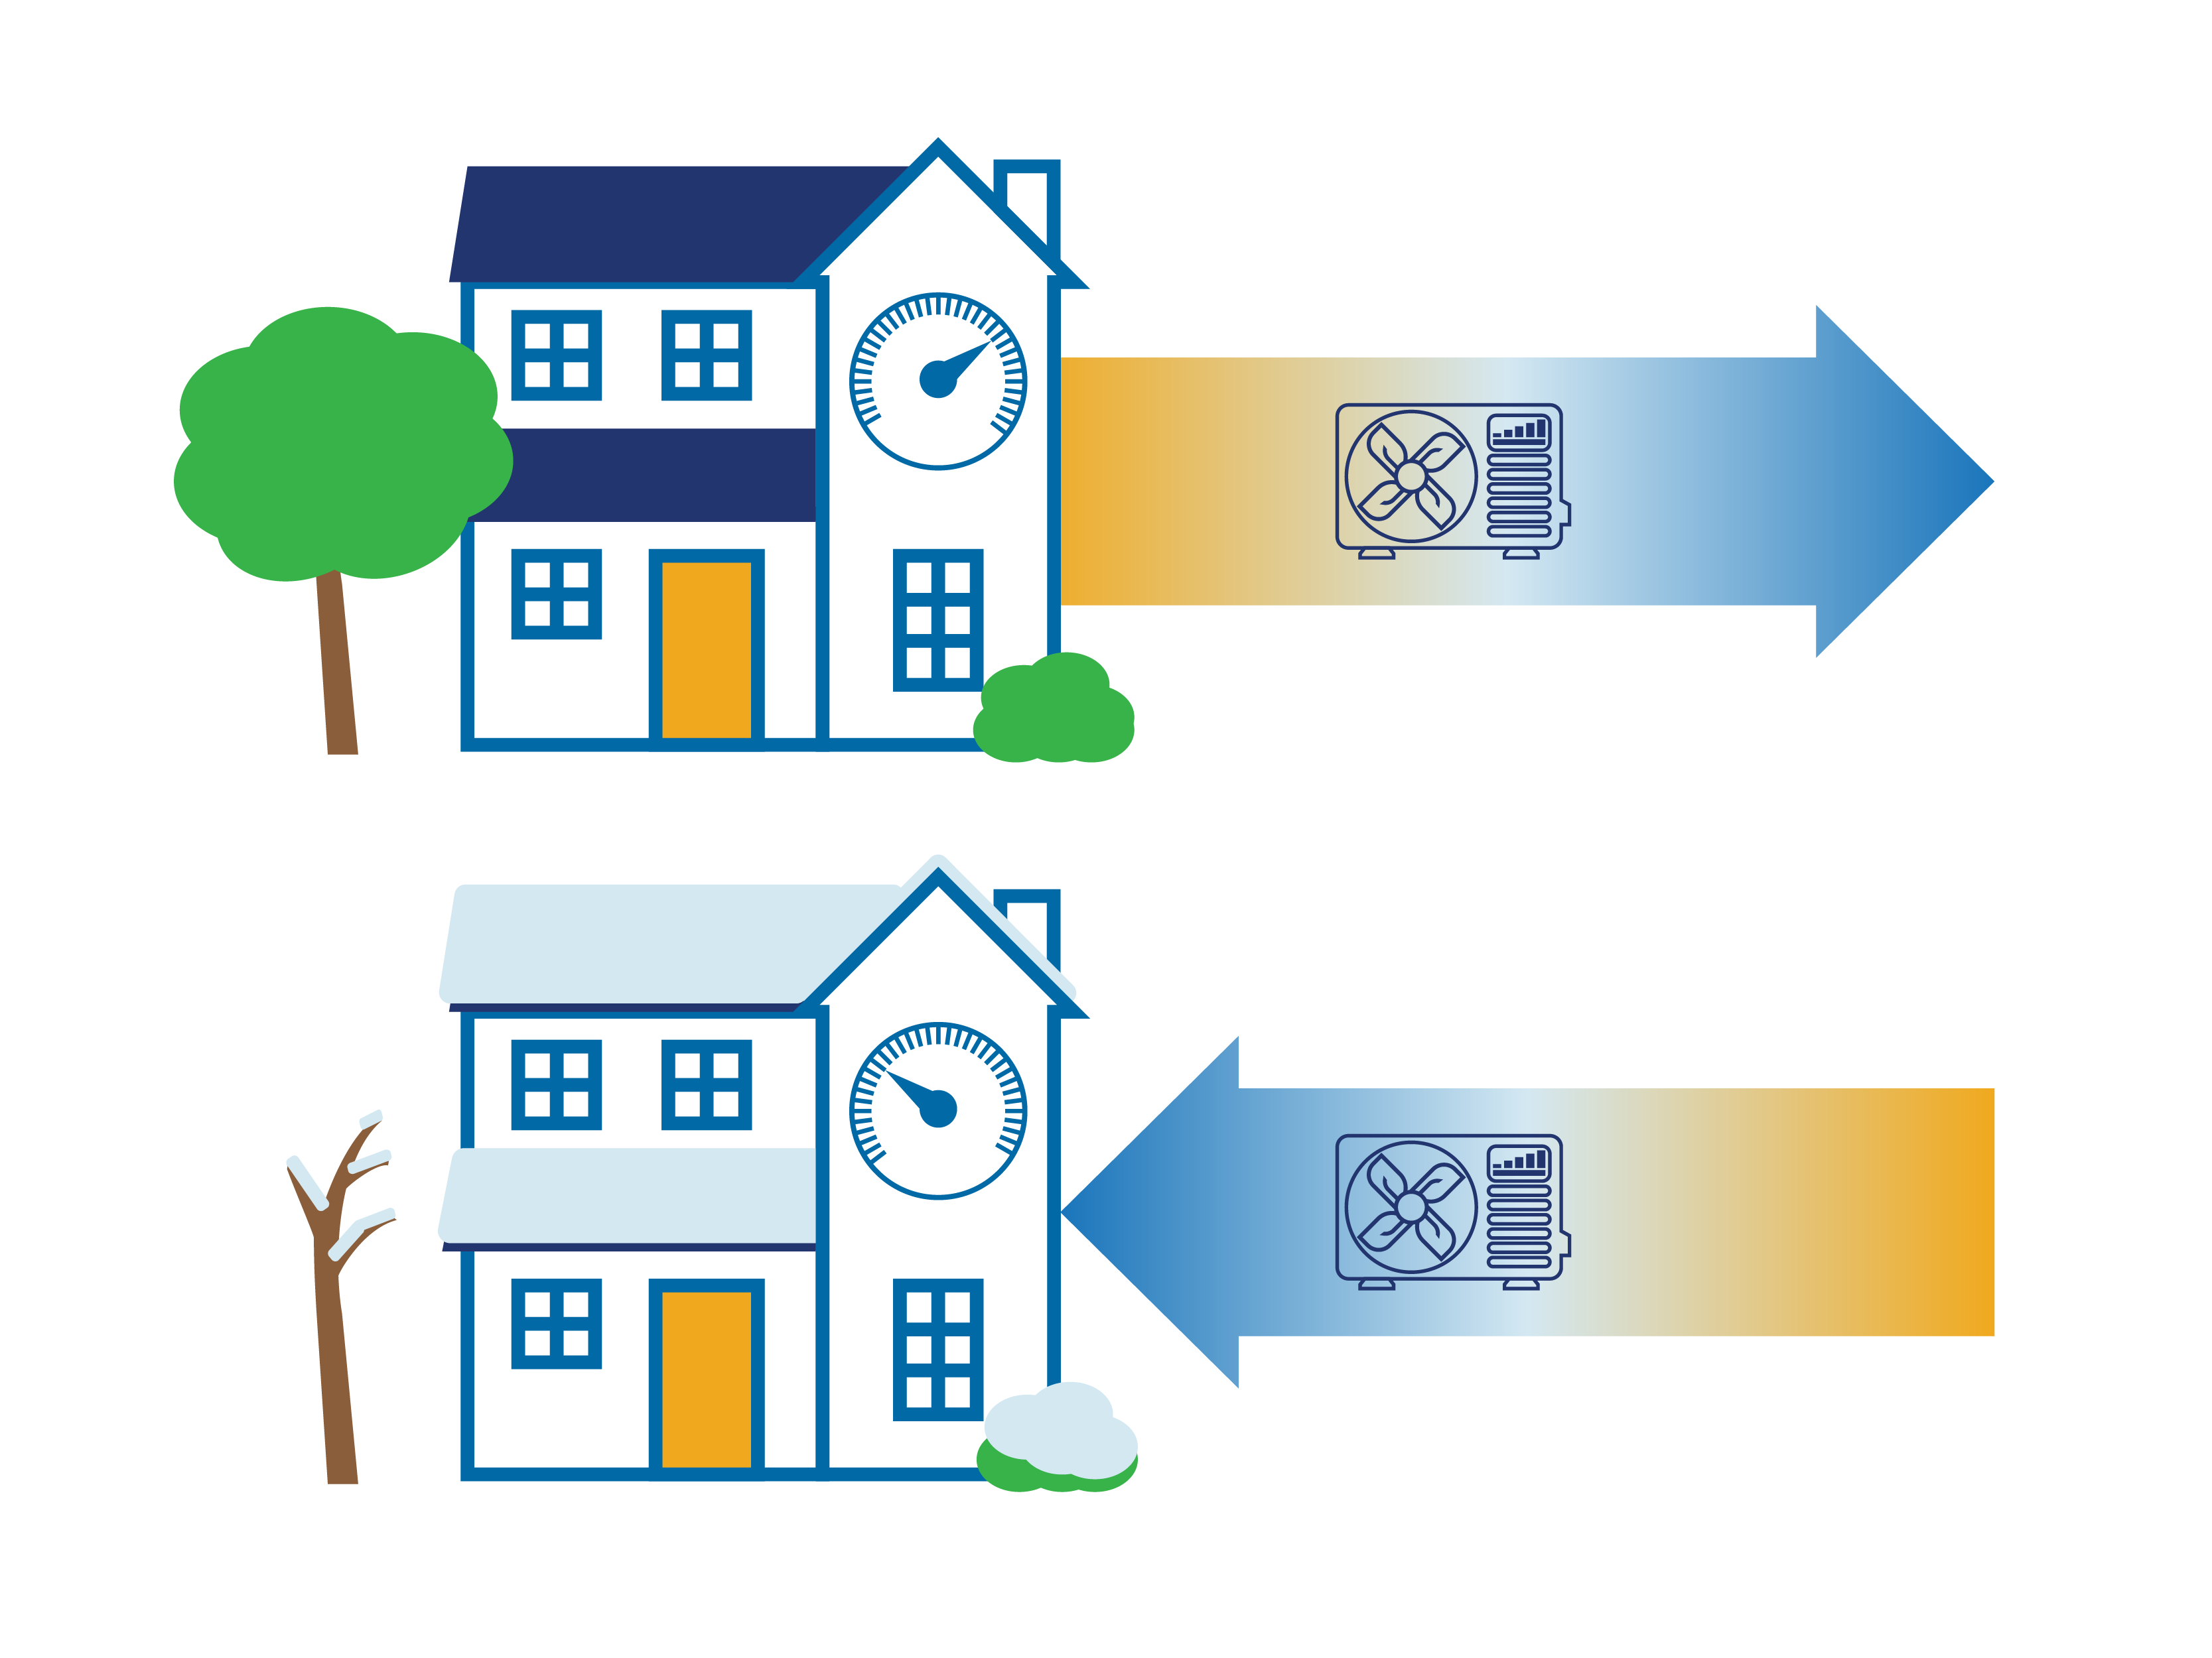
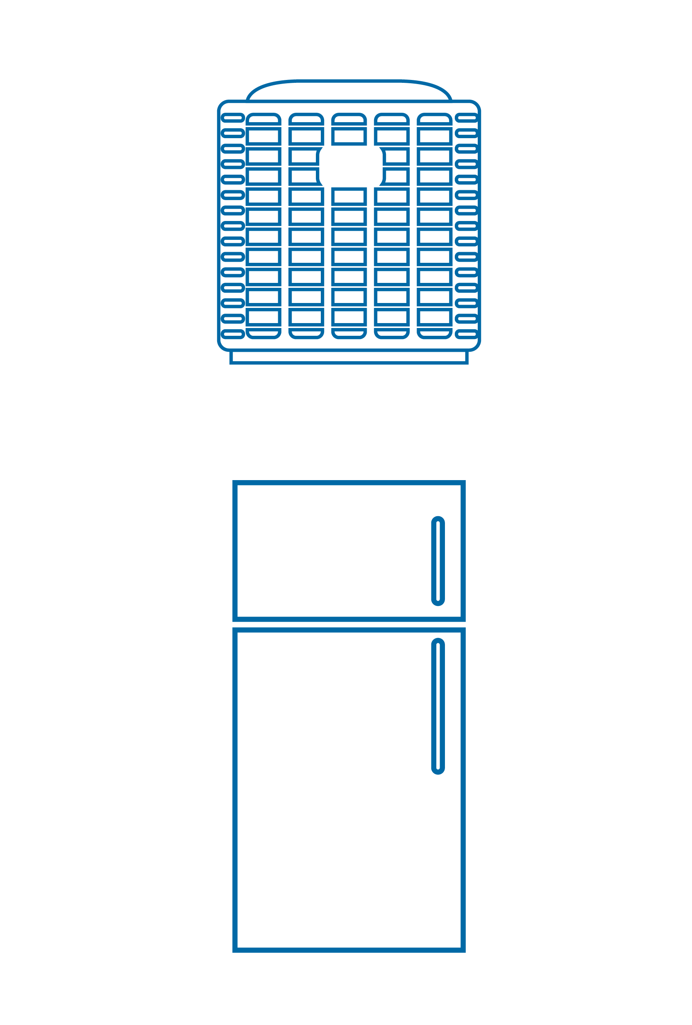
What is a heat pump?
Summer: Pumps heat from
the inside to the outside
Same technology as:
Air Conditioner
Winter: Pumps heat from the outside to the inside
Refrigerator
Notes:
Unlike all other heating systems, the heat pump does not create the heat. It just helps move it. This is how it can achieve efficiencies greater than 100%.
It uses the same technology as a refrigerator, freezer, or an air-conditioner. But unlike traditional air-conditioning it is capable of switching the direction in which it pumps (or transfers) heat, so it can toggle between heating the house and cooling the house.

Slide 7
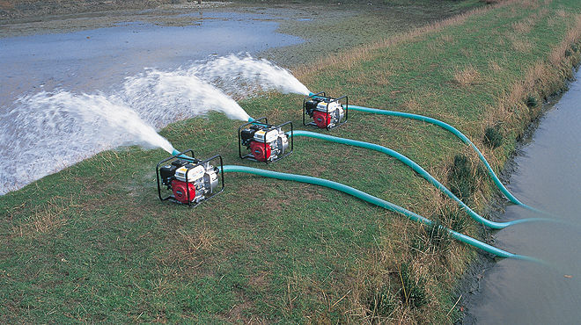
Heat Pumps Do Not Generate Heat, They Move It
Notes:
Therefore, when we discuss energy efficiency of heat pumps, it’s not about how much of the input energy used for operation is actually delivered as useful heat, it is about how much useful heat is pumped or moved by that input energy

Slide 8
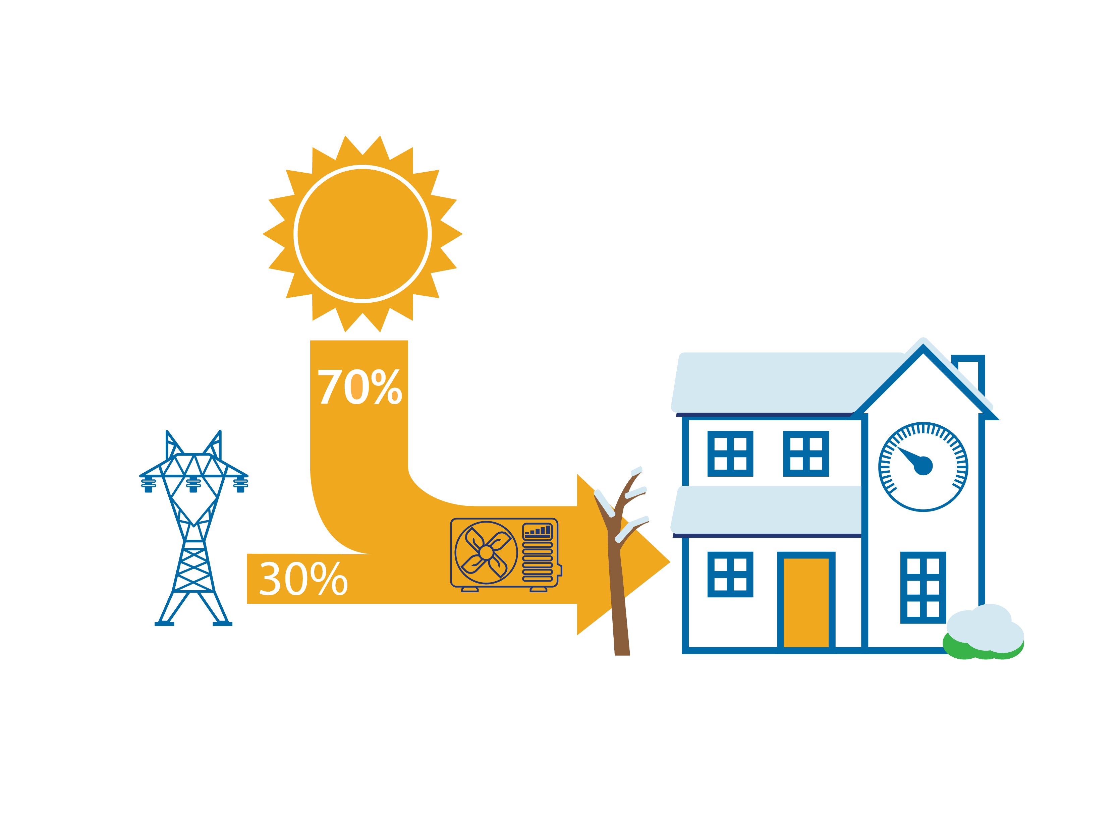
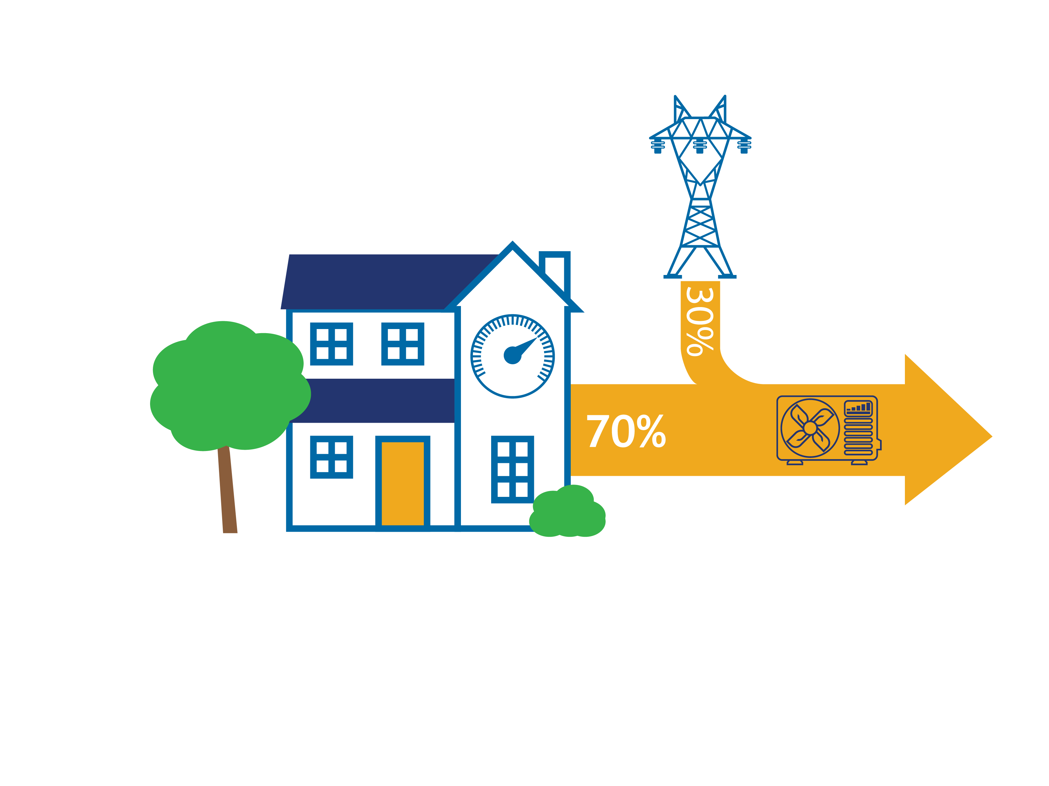
Where does the heat come from?
Heating mode: From the outside air, heated by the sun. Even when it is cold outside.
Cooling mode: From the inside air. It is not bringing in cold, it is removing (pumping) heat.
Notes:
The energy bars shown here are approximate, and they vary depending on the outdoor air temperature. As noted on the previous slide, energy used up by the heat pump itself is used to pump the heat, not to create the heat itself.

Slide 9


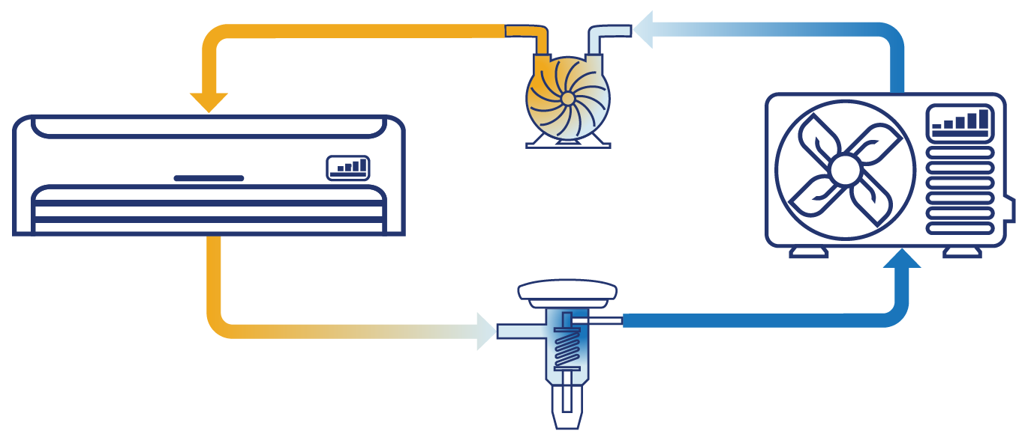
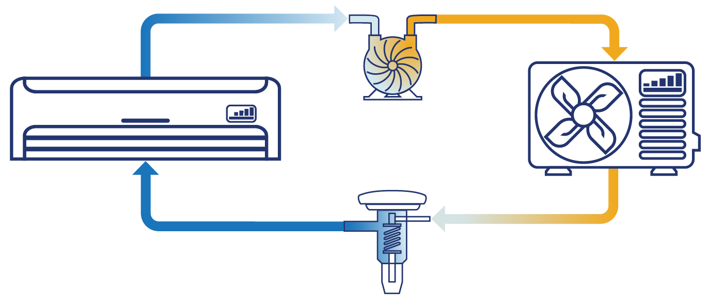
How do heat pumps work?
Vapor Compression Cycle
Pumped refrigerant
Pressurized (liquid) delivers heat
Depressurized (gas) collects heat
Indoors
Outdoors
Cooling Mode
Heating Mode
Notes:
Uses a vapor compression cycle – it moves refrigerant between an outdoor, and an indoor unit. It is able to toggle between heating and cooling mode, simply reversing the flow of refrigerant.
In each location, air flows over refrigerant-filled coils, either adding heat (when the air is hotter) or removing heat (when the air is cooler).
A compressor squeezes (pressurizes) the refrigerant, making it hotter as it goes to the heating end, then an expansion valve lets it depressurize causing it to cool off for the cooling end. (Relatable Example: A compressed air duster (e.g., Dust-ff) becomes cold as its used because the compressed gas in the can is being depressurized. HPs continuously depressurize and repressurize refrigerant gas, which is known as the refrigerant cycle).
Inside the home, the conditioned air (hot or cold depending on the season) is distributed by a fan – either through ducts, or directly at an indoor head.
The ability to change between heating and cooling is what makes a heat pump special and differentiates it from an air-conditioner which can only pump heat in one direction.

Slide 10


The many names of a heat pump
Air Source Heat Pump
(ASHP)
Variable Capacity Heat Pump
(VCHP)
Cold Climate Air Source Heat Pump
(ccASHP)
Cold Climate Ductless Heat Pump
(ccDHP)
Also Known As:
Inverter driven
Extended capacity
Extra performance
Extreme climate
Various branded trade-names:
Hyper heat®, Aurora ®, Halcyon XLTH ®, Max-Heat ®
Notes:
All heat pumps operate using the basic principle just described. However, some heat pumps are designed to optimize their performance for increased comfort, energy efficient operation, or when operating in cold climates. Additionally, Heat Pump manufacturers have various trade-marked names associated with their products to describe their enhanced performance equipment in comparison to “standard” Heat Pumps. However, very nature of heat pumps make standardizing the definition of a “cold climate” heat pump challenging. That’s why organizations like NEEP and NEEA have worked to establish standard definitions that are applicable across manufactures.

Slide 11
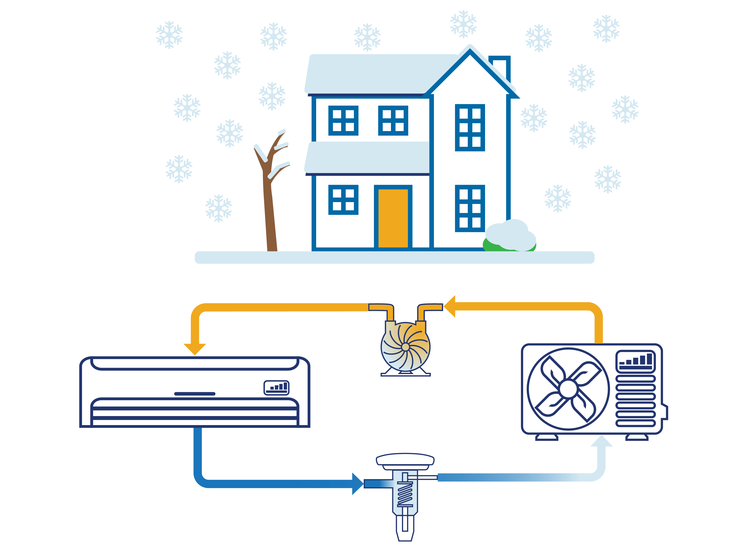

Cold Climate Air Source Heat Pumps
Specially tuned to do well in cold climates
Meets efficiency and capacity criteria set forth by the Northeast Energy Efficiency Partnership (NEEP)
Improved components combine to provide variable speeds
Standard heat pumps are single-speed or two-speed only
Akin to a fixed speed bike vs. a 21-gear bike
Notes:
The term ccASHP refers to products listed on the NEEP ccASHP products and specification list
ccASHPs are a subset of what are also called variable capacity heat pumps, extended capacity heat pumps, or inverter driven heat pumps. The key is multiple operating speeds that can be fine tuned to match the indoor need and outdoor condition, rather than just on vs. off.
The same added capabilities that allow for improved heating performance on the coldest days extend its cooling performance on the hottest days.

Slide 12
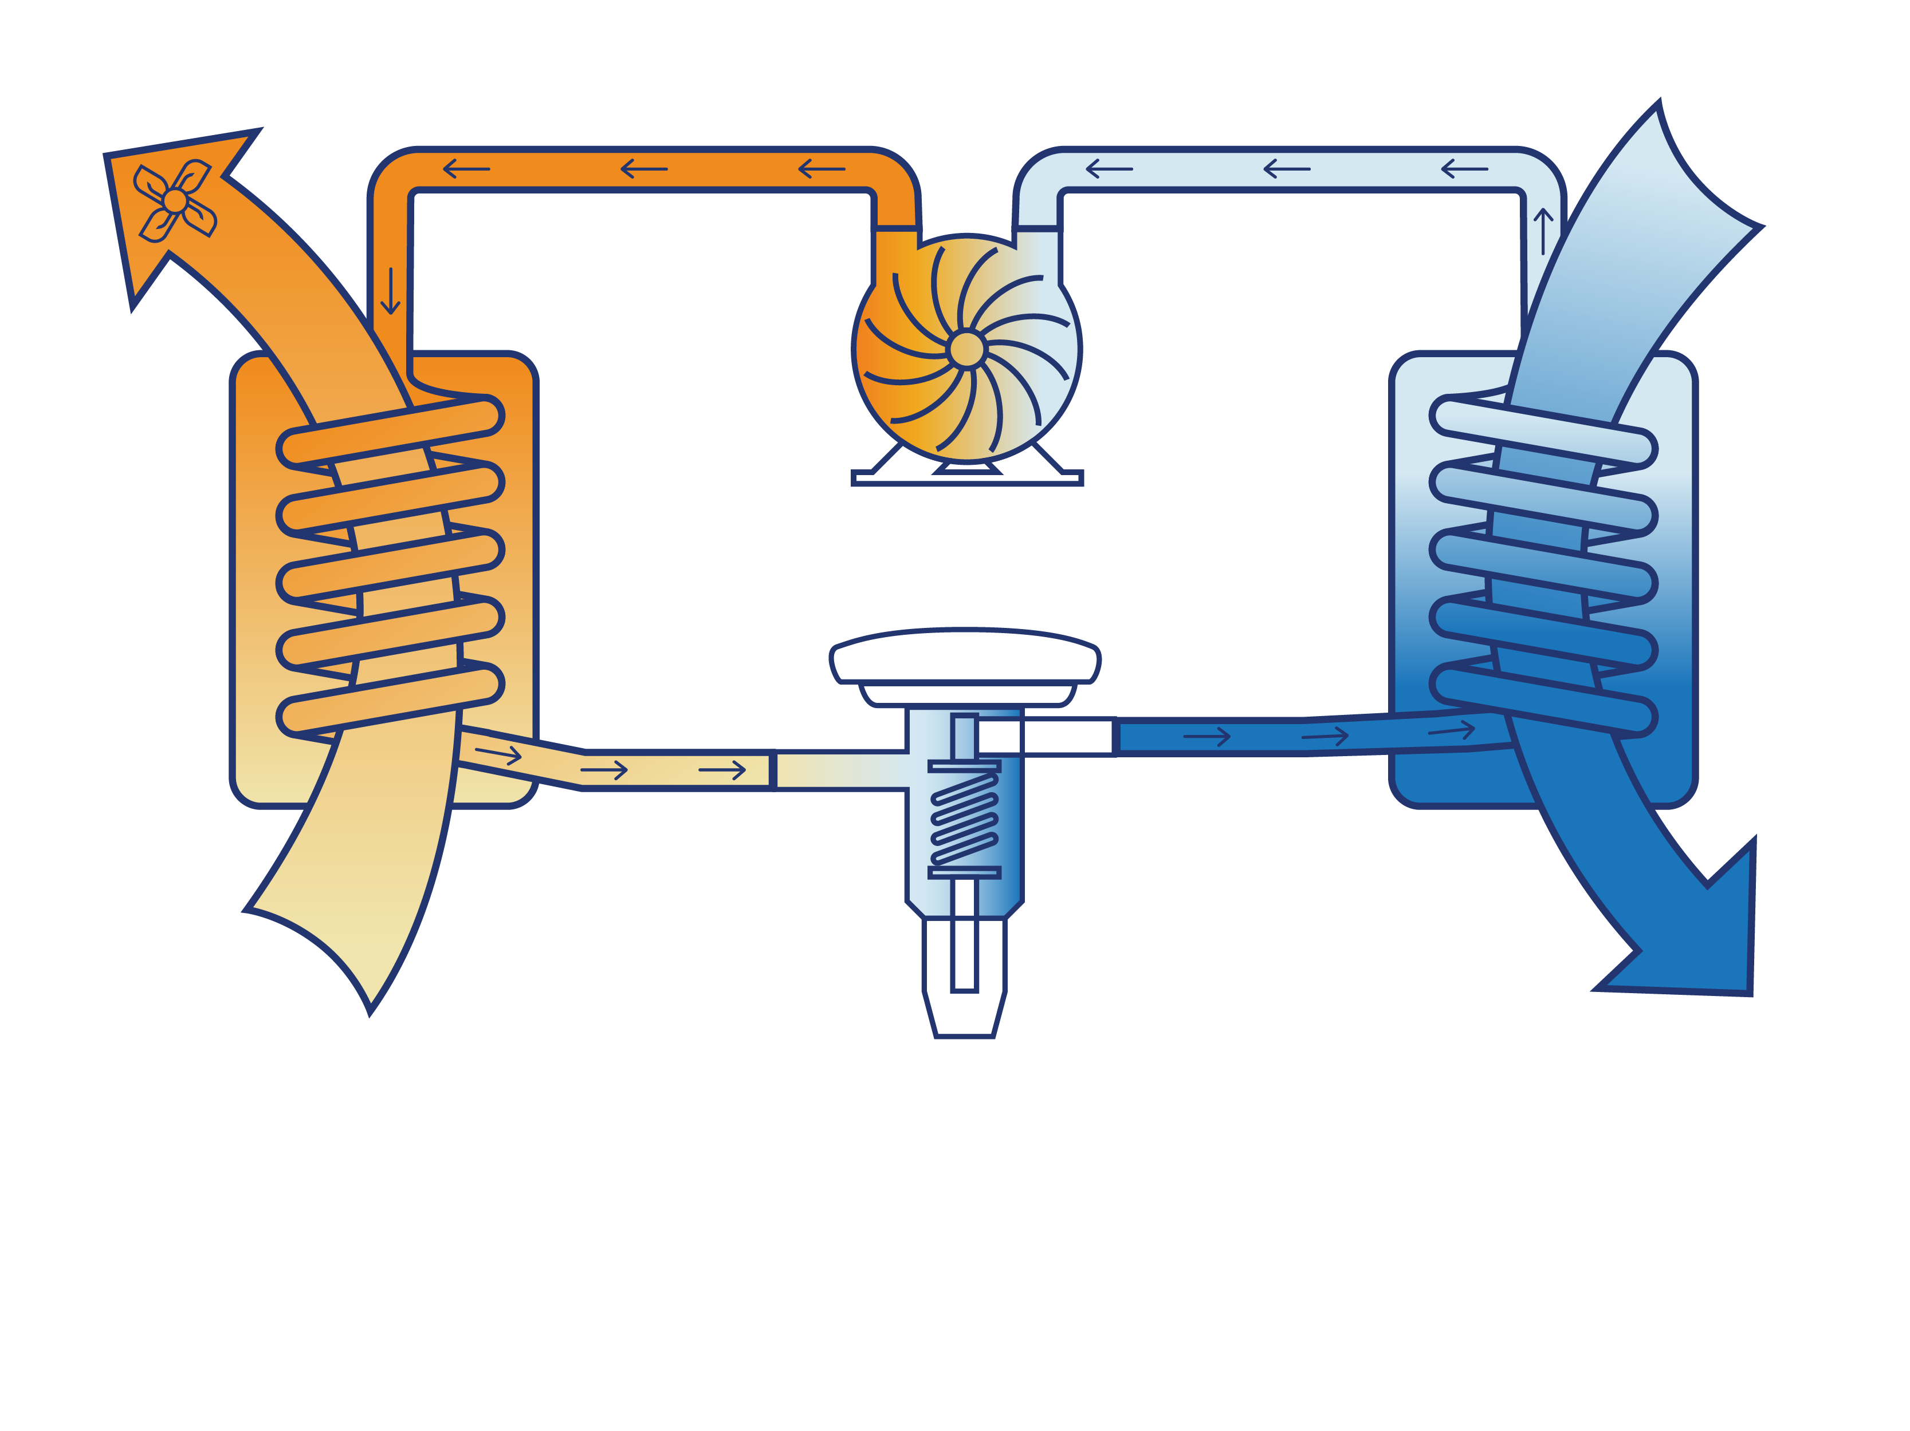
Heat Pump Components
2
1
Compressor
Fan
Indoor Unit:
Condenser
Outdoor unit: Evaporator
Useful Heat
Heat Source
Indoors
Outdoors
3
Expansion Valve
Heating Mode
Notes:
Reiterate the explanation of the Vapor Compression Cycle introduced on the prior slide
Pumped refrigerant
Pressurized (liquid) delivers heat
Depressurized (gas) collects heat
Restate that this is showing heating mode only. When the system is in cooling mode, the cycle essentially goes in the opposite direction, and the roles of the indoor and outdoor units (condenser and evaporator) swap
The evaporator: in heating mode this is the outdoor unit, where cool liquid refrigerant evaporates into warm gaseous refrigerant, pulling heat out of the air. In the summer, the indoor unit is the evaporator
The compressor: this compresses warm gaseous refrigerant into hot-gaseous refrigerant, to send to the condenser for release
The condenser: in heating mode this is the indoor unit, where hot-gaseous refrigerant condenses into warm liquid refrigerant inside the coil, releasing its heat in the process. In the summer, the outdoor unit is the condenser, releasing heat.
The fan: this blows air across the indoor unit’s heating coil, helping to release the heat (in winter) or pull the cool air (in summer). It’s how the energy is transferred from the unit itself into the house. The speed of airflow impacts that rate of energy transfer
The expansion valve: this regulates how much refrigerant flows through the loop overall. As warm-liquid refrigerant passes through it, it turns to cool-liquid due to lower pressures on the other side of the valve, and is now ready again to collect heat in the evaporator.
Of all these items, 3 can be controlled dynamically to adjust heat transfer and energy use: Compressor, Fan, Expansion Valve (described on the next slide)

Slide 13


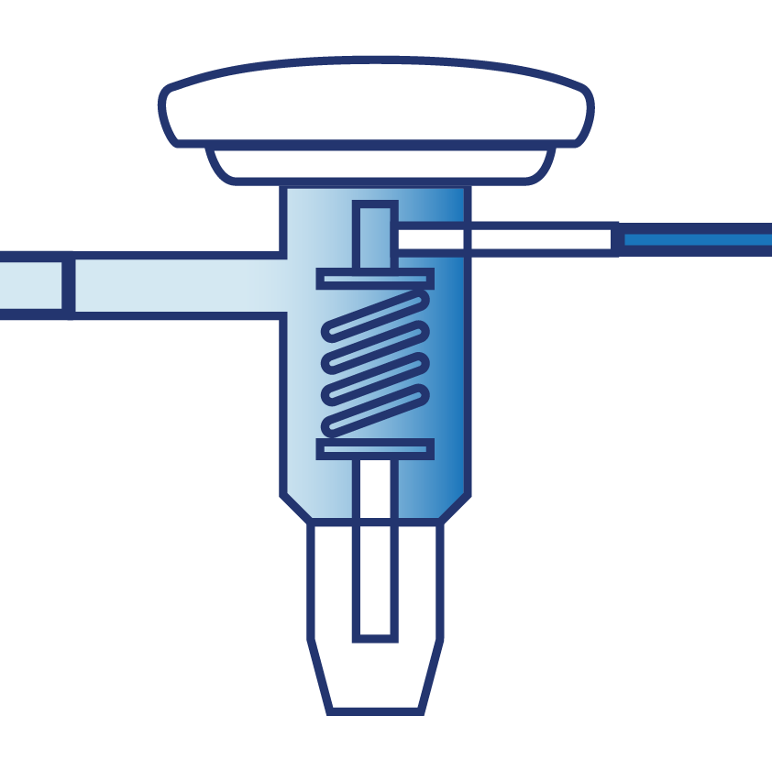
Variable Capacity Heat Pump (VCHP) Component Differences
Compressor motor is inverter driven for multi-stage variance
Compressor
Fan is controlled by an electronically commutated motor for variable speeds
Fan
Expansion valve controlled by an electromagnetic piston to vary the firing rate
Expansion Valve
Notes:
The three components are controlled based on finely tuned control algorithms to deliver the right amount of heat for the current need based on the current conditions.

Slide 14
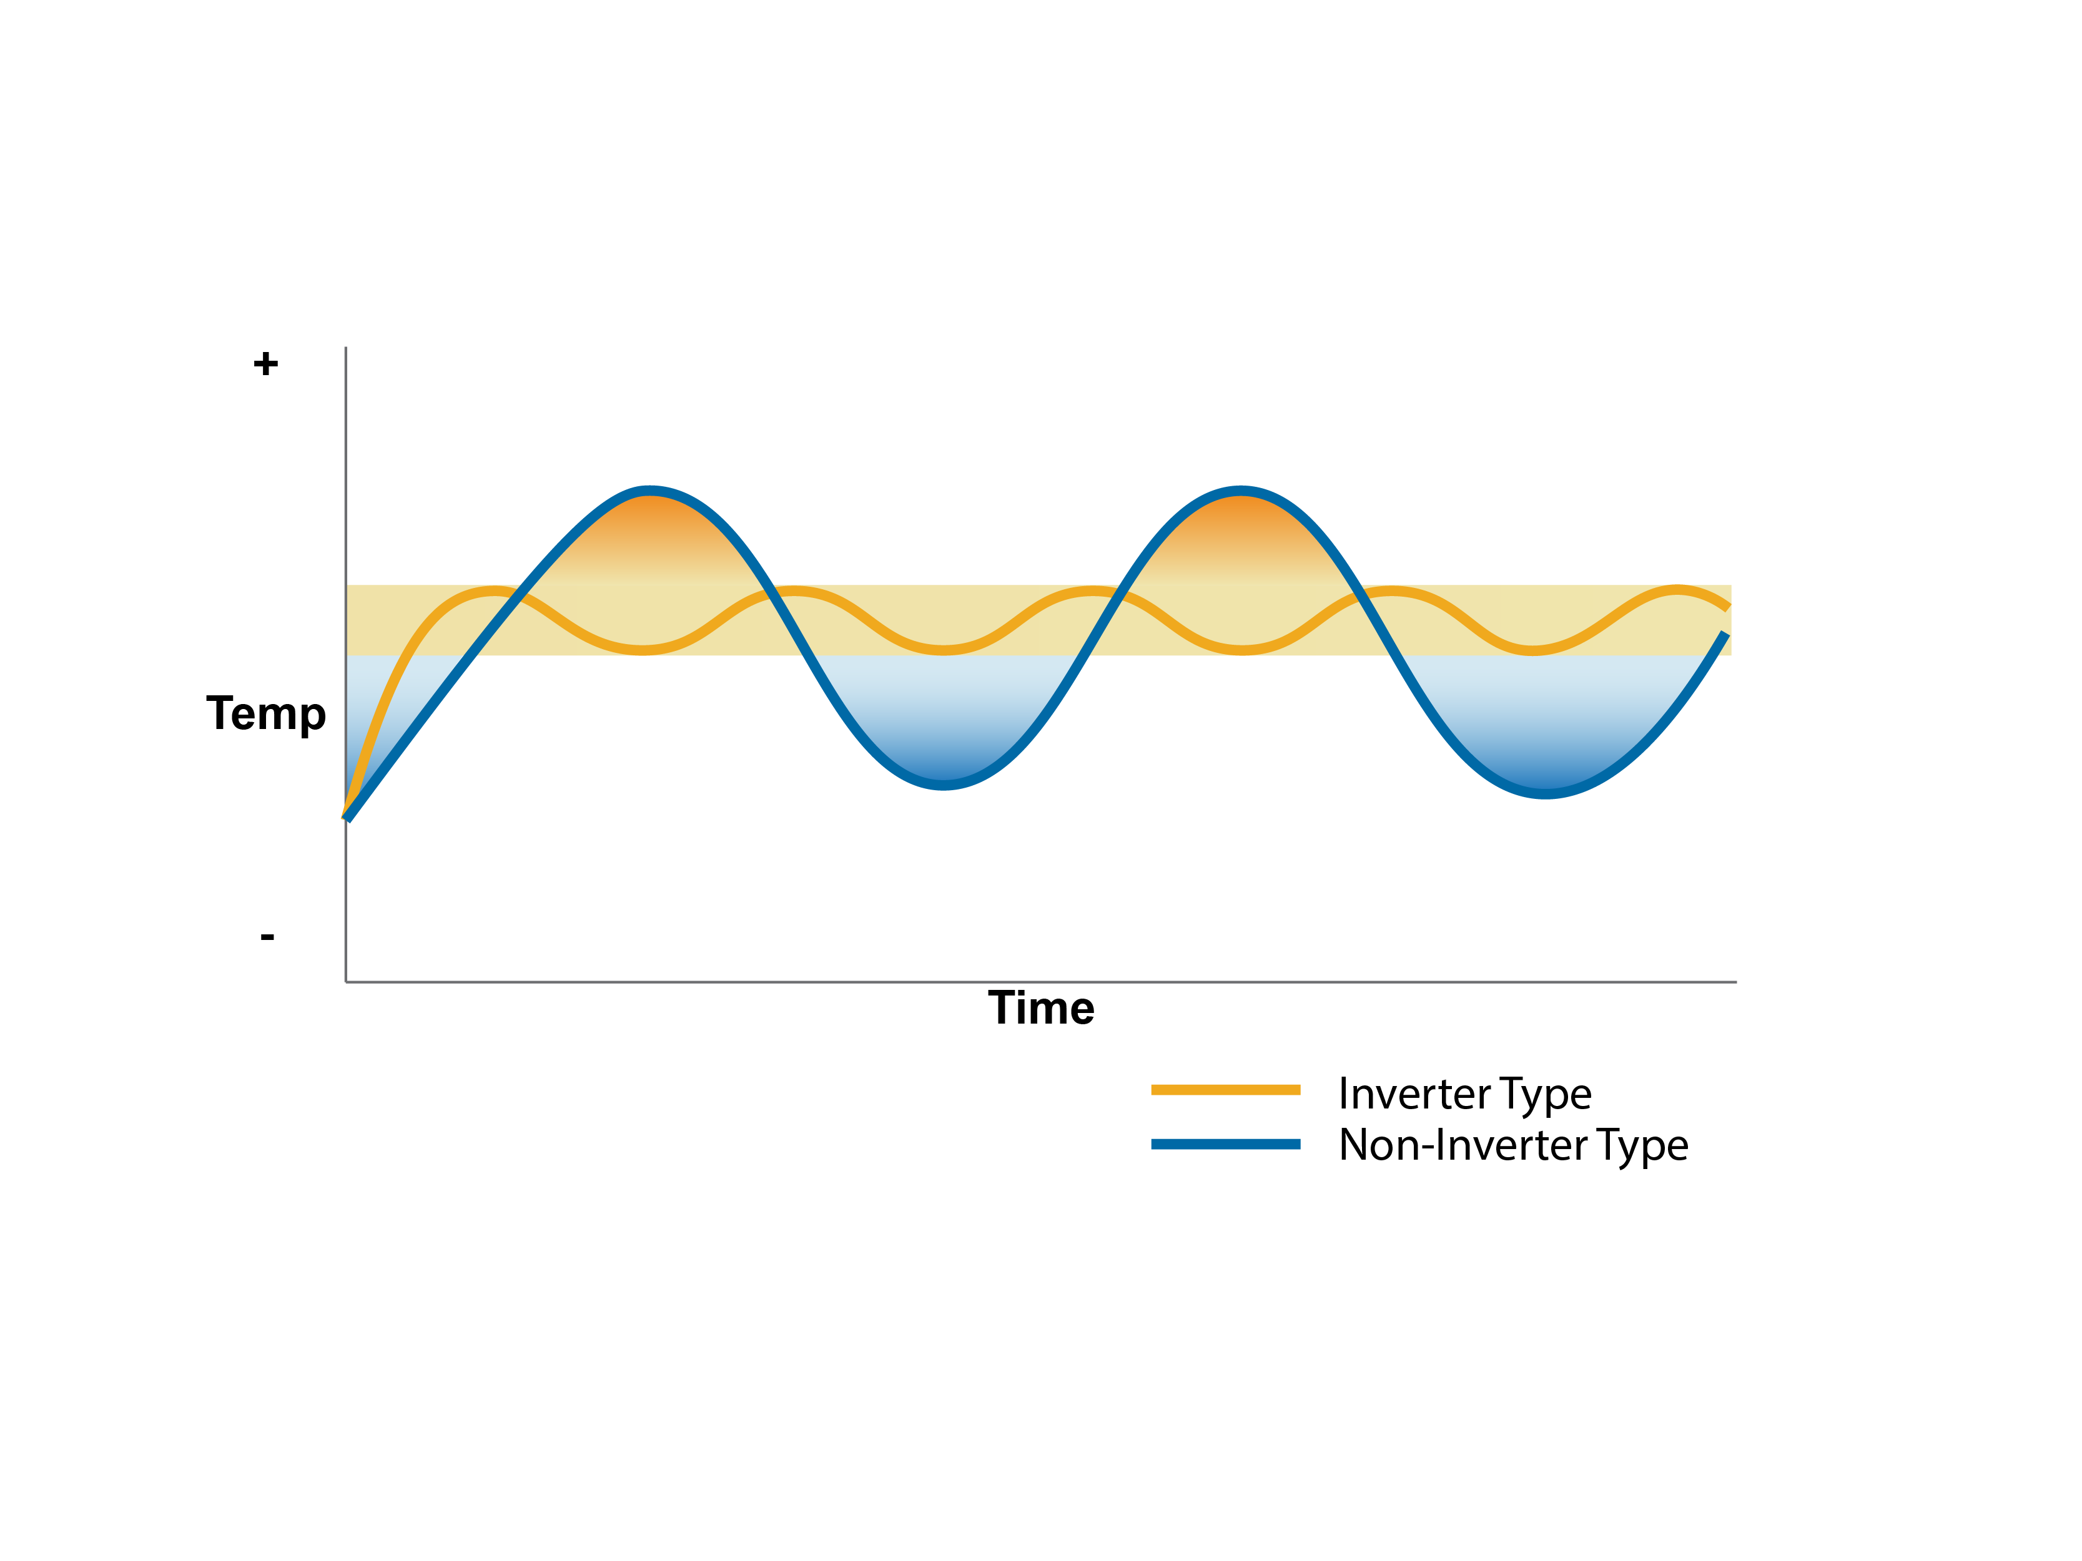
How Modulation Helps - Control
Recovery Speed
More control
Less waste
Improved comfort
Notes:
Variable capacity heat pumps have multiple speeds and can modulate. They have a high-gear for faster recovery speed (though frequent use of that speed is inefficient), and lower gears for steady operation and tighter control.
Non-VCHPs typically have only 1 or 2 speeds. This means slower recovery, and often overshooting the thermostat signal. It is like a teenager learning to drive and toggling between slamming the gas pedal and slamming the breaks.

Slide 15
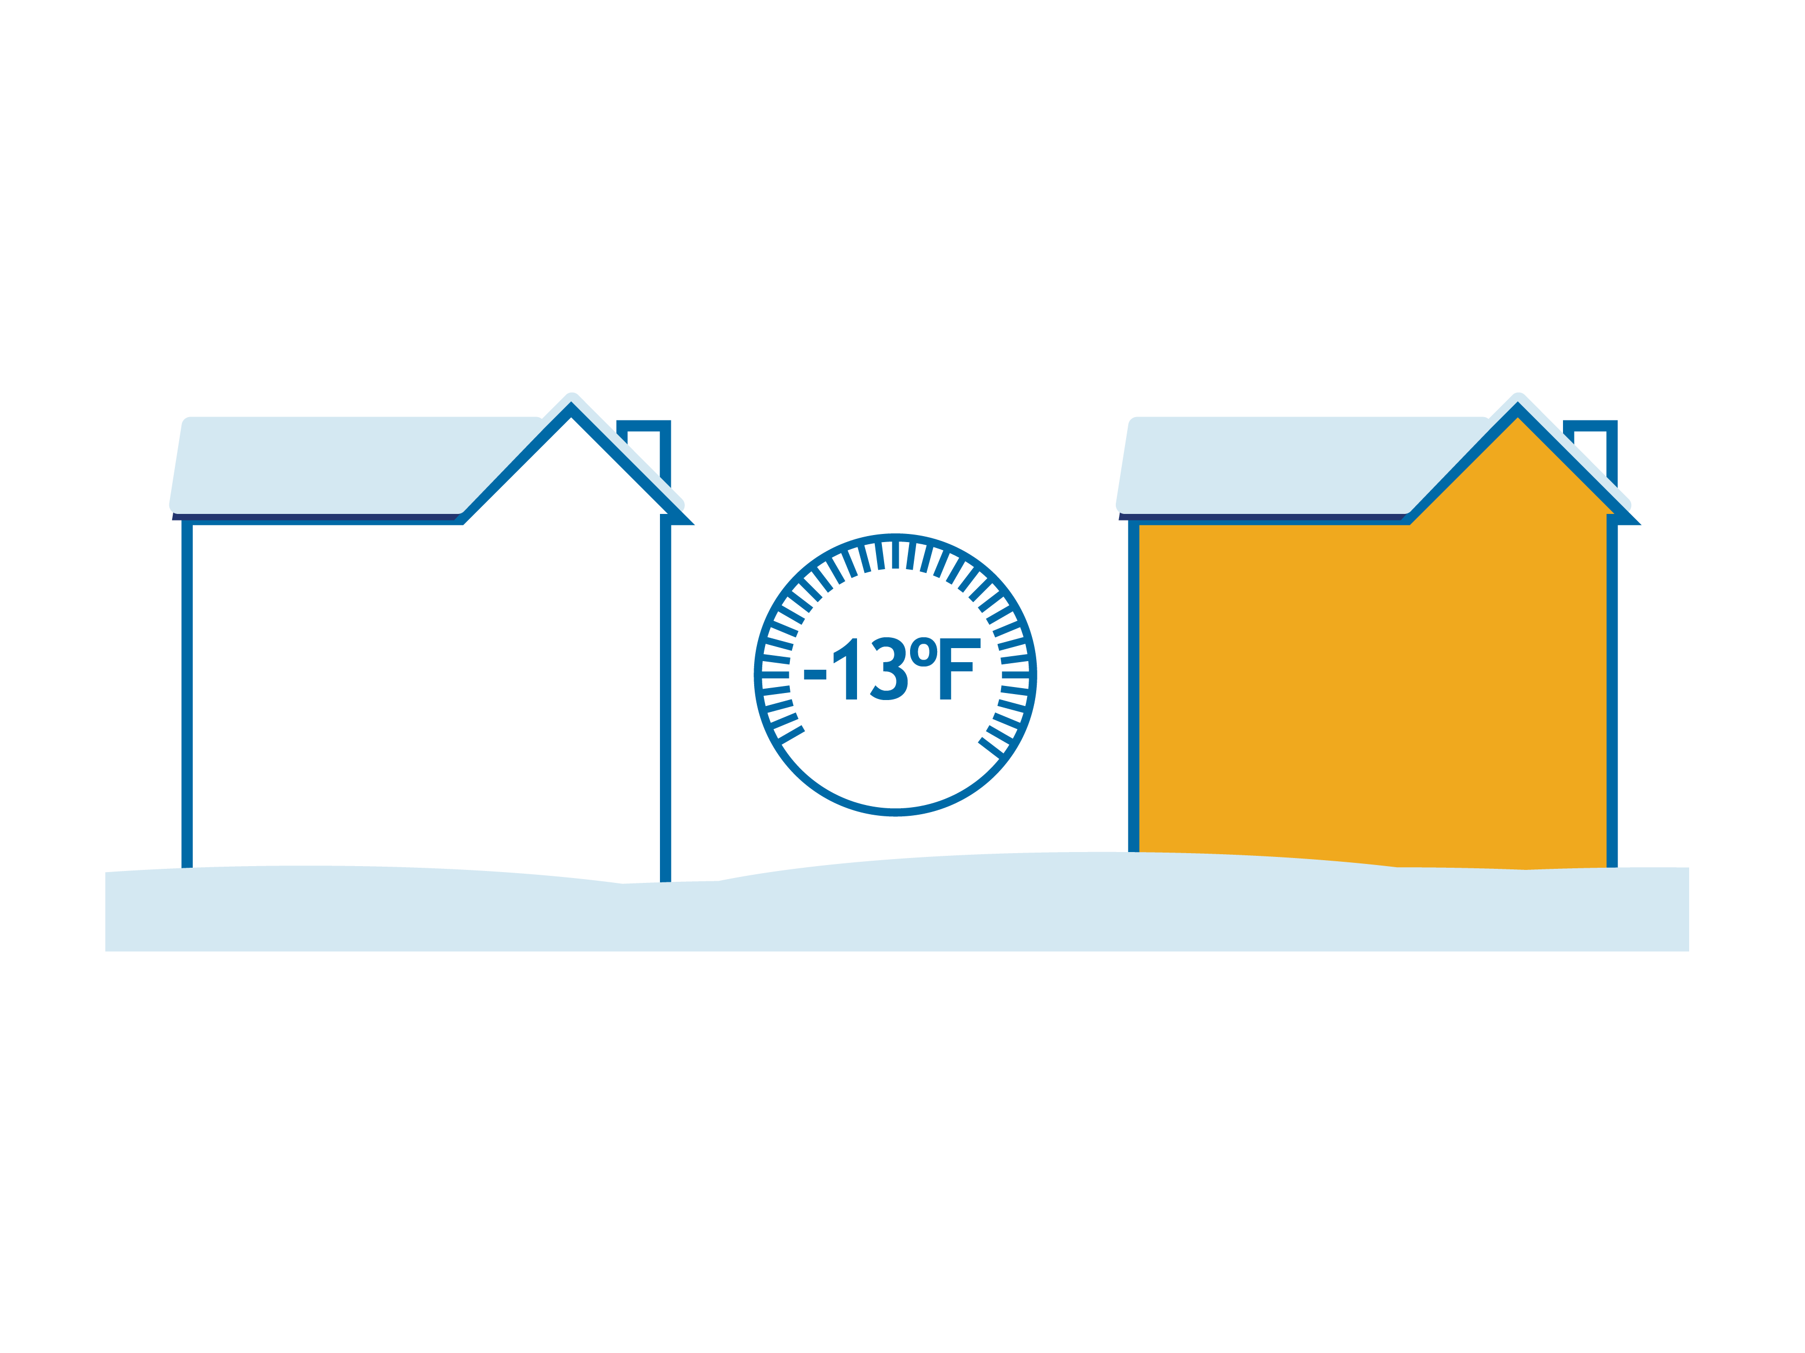
How Modulation Helps – Capacity
Traditional heat pumps cannot perform at low temperatures and therefore require supplemental heat
Cold climate heat pumps require less supplemental heat
Conventional Heat Pump
Cold Climate Heat Pump
0%
72%
Capacity
Capacity
Notes:
Cold climate heat pumps adjust the compressor speed and expansion valve settings leading to the right refrigerant pressure at the outdoor unit to still collect outdoor heat, even at extremely cold outdoor temperatures. The precise amount at any given temperature will differ model to model.

Slide 16


NEEP’s Cold Climate Specification
Variable capacity, residential-scale, air source heat pump. Ducted or ductless
High rated heating efficiency (≥8.5 HSPF2 ductless, ≥ 7.7 HSPF2 ducted)
High efficiency even at 5°F (COP ≥ 1.75)
Highly rated cooling efficiency
Capacity and efficiency data reported at multiple operating conditions
Sets and periodically updates the standard
Maintains a qualifying product list
Publishes the resultant engineering data
Notes:
Cold climate heat pumps are a subset of what are generically called a variable capacity heat pump, extended capacity heat pump, or inverter driven heat pump. The key is multiple operating speeds that can be fine tuned to match the indoor need and outdoor condition, rather than just on vs. off.
The same added capabilities that allow for improved heating performance on the coldest days extend its cooling performance on the hottest days

Slide 17
INTERACTION TIME! ASHP Function and Efficiency
Remote Delivery
Use polls to 1) name the parts of a heat pump and 2) ask which part of the heat pump does what
How does a heat pump achieve >100% efficiency?
In-person
Show parts of the heat pump and a list of functions – participants call out the match-ups like the “price is right”
Participants call out how heat pumps achieve >100% efficiency
Notes:
Remember that efficiency in this context is delivered heat, divided by input energy. Since the delivered heat comes from the air, it is not breaking thermodynamics, as it is not converting the input energy to delivered heat.

Slide 18
Part 2 Using Load Calculations
Notes:
In this section, we will review the principles behind performing load calculations, and how they apply to system sizing and design.

Slide 19
Load Calculations Learning Outcomes
Understand what a load calculation is
Learn the basics of performing a load calculation
Understand what affects the heating and cooling load of a home
Learn about different resources available to contractors
Understand key considerations for performing an accurate load calculation
Notes:
Discuss why this is important to the audience. Cater to the specific audience’s roll and pre-knowledge.
Homeowner’s perspective
Contractor’s perspective
Accurately determining how much heat is needed and where it is needed is a critical first step before sizing and specifying the heat pump. Reducing the load first will save money, improve comfort, and simplify the heat pump decision process.

Slide 20

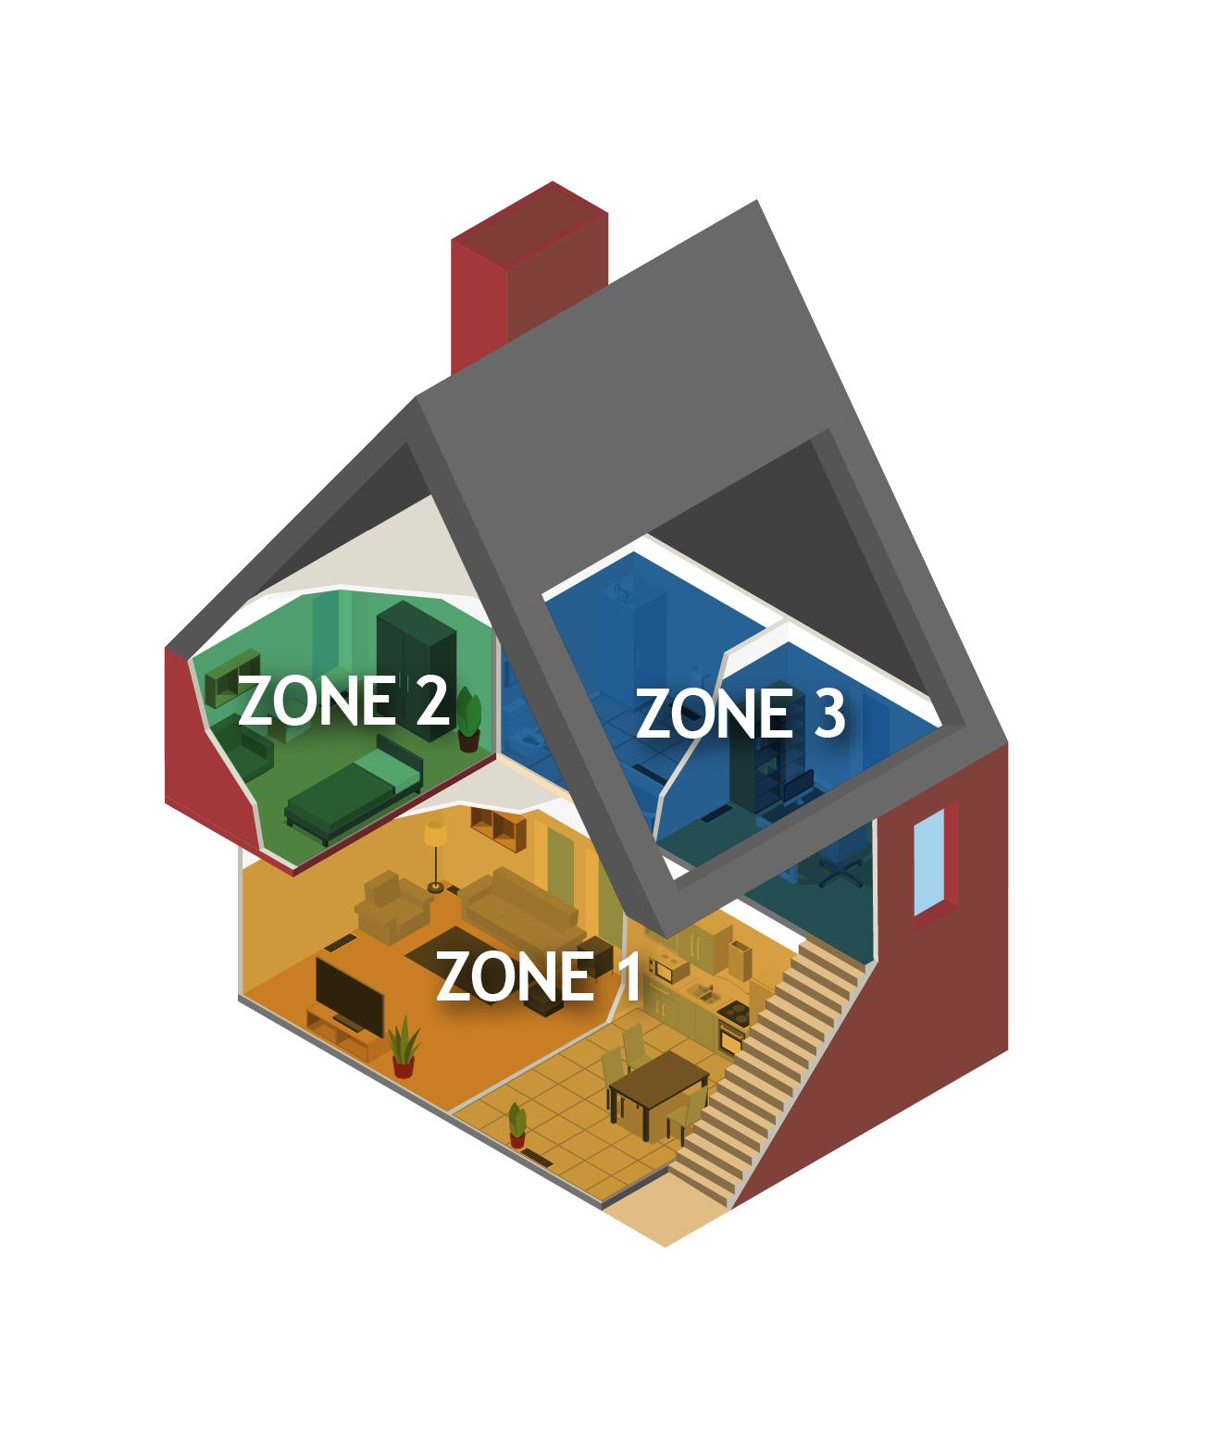
Load Calculations What are they?
How much heat is needed?
In the home (block load)
In a zone (e.g., floor or wing)
In a room
What goes into the calculation?
Design temperature (the regional climate)
Size of the home
Insulation – walls, ceilings, floors
Window quality and location
Building orientation
The colder it is outside, the more heating energy needed to stay comfortable.
The heating load is judged based on the coldest day of the year.
Notes:
A home’s heating load is the amount of heat needed at any given time to maintain it is comfortable room-temperature. The energy going out through the envelope must be met by the heat supply.
Technically, the heating load is usually based not on the coldest day, but the 99th percentile coldest. This is true for traditional heating systems too. The coldest hours are so infrequent and short term the system can recover after those hours have passed.

Slide 21

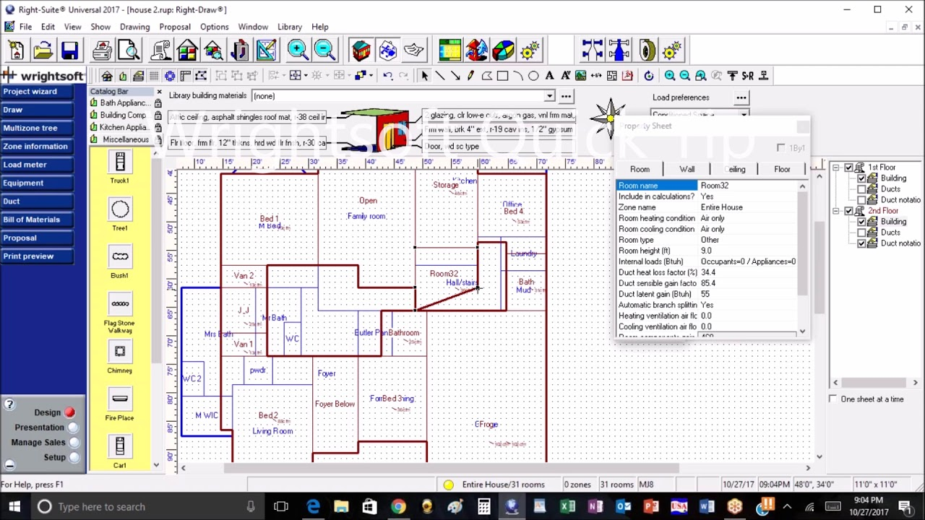
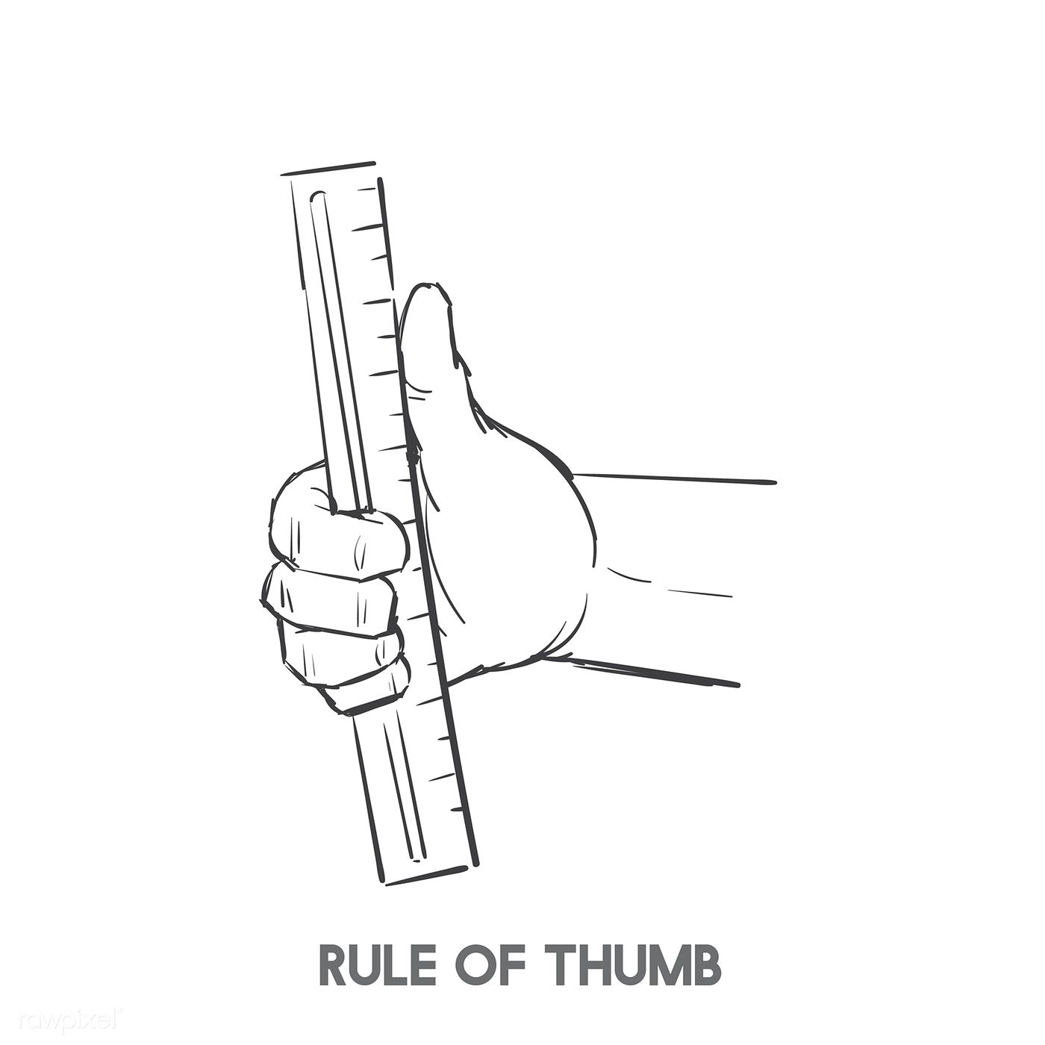
Load Calculations How are they done?
Standardized process using energy modeling software tools
Supports system selection and design
Be accurate to the building
Garbage in -> garbage out
Rules of thumb only as a sanity check
Notes:
Gather all the home data available – insulation levels, size, windows (size, u-factor, SHGC, location), orientation. Enter it into the software tool. Enter the location. Run the tool. Check your results.
Rules of thumb on heating size have built up over decades of past experience, but that is all based on natural gas or oil-based heating. Heat pumps are different! Those rules of thumb don’t apply and typically result in oversizing the heat pump, which leads to poor performance.

Slide 22
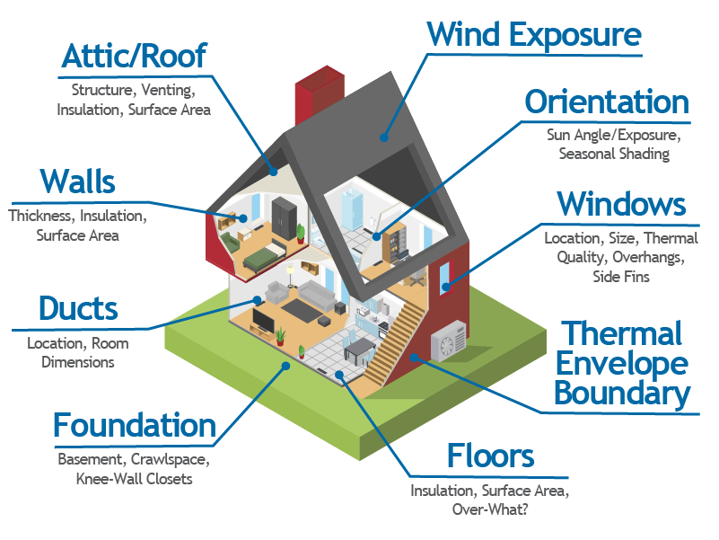
Home Takeoffs What impacts the load?

Slide 23
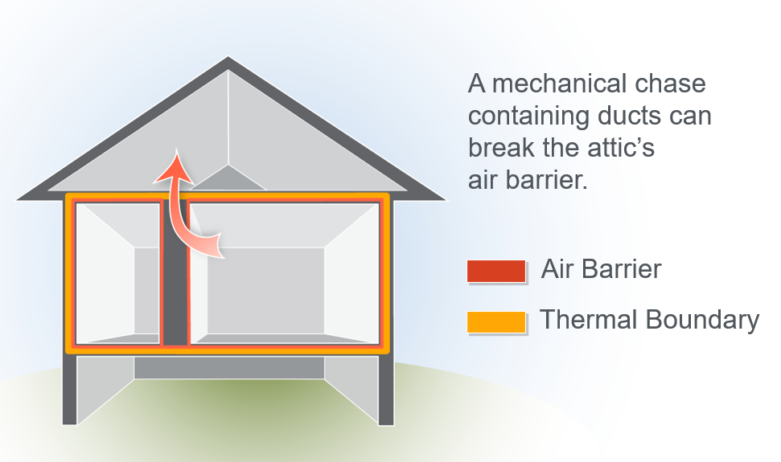

Load Reduction Reduce the load first, then size for heating
Tenets of load reduction
Define the thermal boundary/envelope
Air seal
Top plates, joists
Recessed lights, duct boots
Penetrations
Weather stripping
Chimney dampers
Test with a blower door
Insulate
Attics, walls (if accessible)
Windows
Perform load calculations after load reductions
Improved comfort
Smaller, less expensive heat pump
Reduces heat distribution challenges (ducting, indoor head locations)
Can make ductless applications more viable
Notes:
In all cases it is significantly better to reduce the load first, then size the new system. This can allow for smaller, and less expensive, heat pumps, and ensure the system is not oversized for the home’s actual need. This will also make it easier to match available heat pumps to the home’s overall load and energy need across all conditions. A leaky, high-load house requires a larger heat pump to cover the peak-heating need, which inevitably leads to an oversized heat pump for more mild-conditions. More on that dynamic later in this presentation.

Slide 24
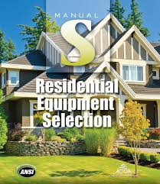


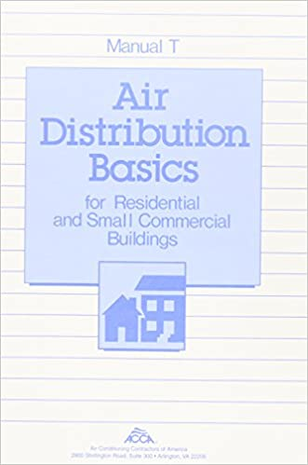
Load Calculation Software Whole house, room by room
Air Conditioning Contractors of America (ACCA) Tools www.acca.org:
Manual J – Load Calculations
Manual S – Equipment Selection
Manual T – Air Distribution
Manual D – Duct Design
Wrightsoft (Right-J8) and Elite (RHVAC) are the industry premium products
Information on other ACCA-certified products available at: www.acca.org/standards/approved-software
Notes:
You can calculate load by whole-house, zone-by-zone (sometimes call block-loads) and/or room-by-room. Room-by-room is essential for duct sizing or ductless head location even in a whole-home heating configuration.

Slide 25

Load Calculation Support and Alternatives
Alternative methods and tools exist for design
Manufacturer specific tools
Northwest Energy Efficiency Alliance (NEEA) HVAC Sizing Tool
Sizing and selection guides for heat pumps can help
NEEP’s Guide To Sizing & Selecting Air-Source Heat Pumps in Cold Climates
NEEA’s ccDHP Sizing Recommendations
Notes:
New York State Department of State officially requires Manual J/S documentation for code compliance, but it allows jurisdictions to grant local approval of alternative methods. However alternative methods and tools can be valuable or useful compliments to Manual J.

Slide 26
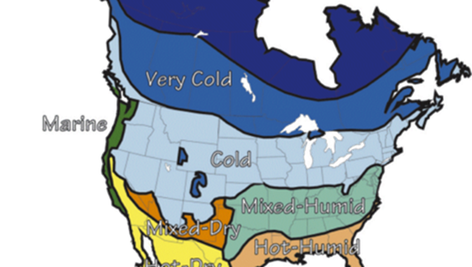
North American Climate Zones
The home’s location and climate dictate the heating and cooling loads
Different heat pumps are appropriate depending on the climate zone
Climate dictates the home’s load and the heat pump’s environment
Image credit: Building Science Corporation

Slide 27
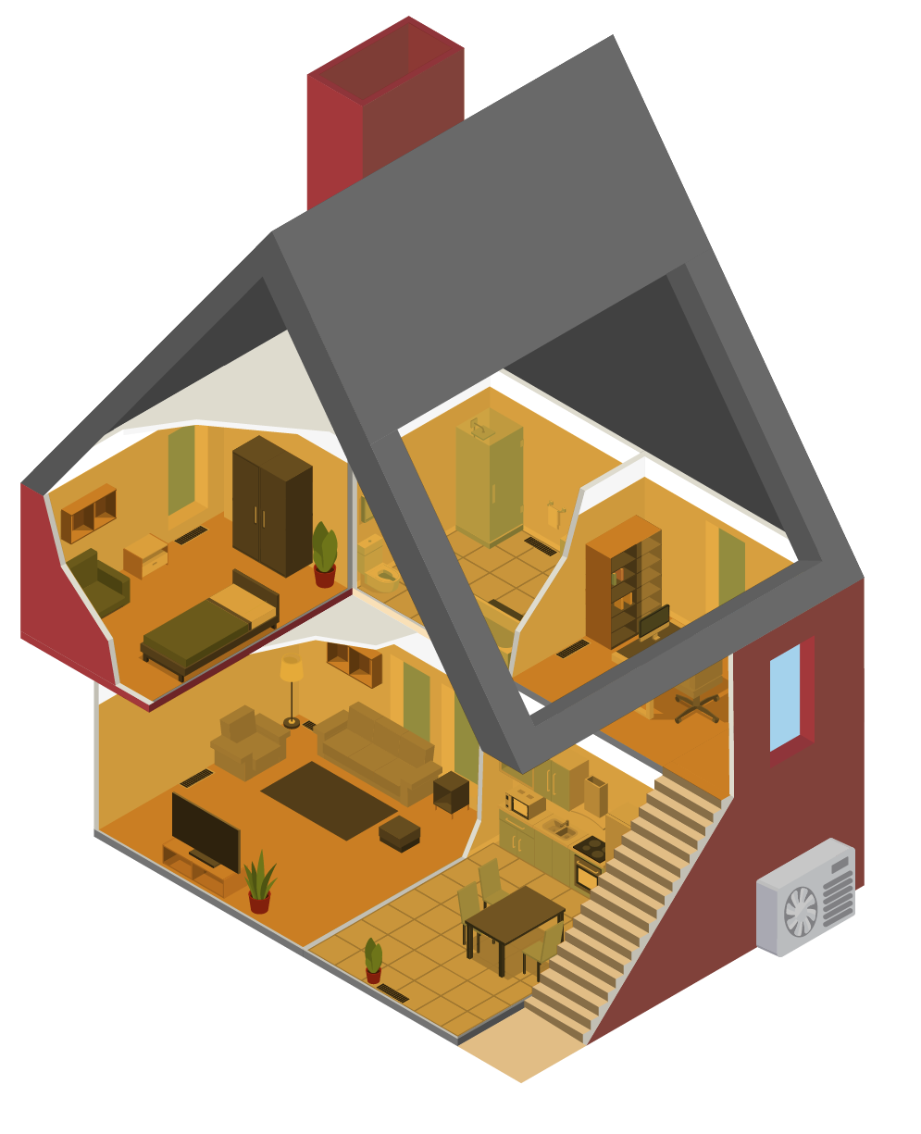
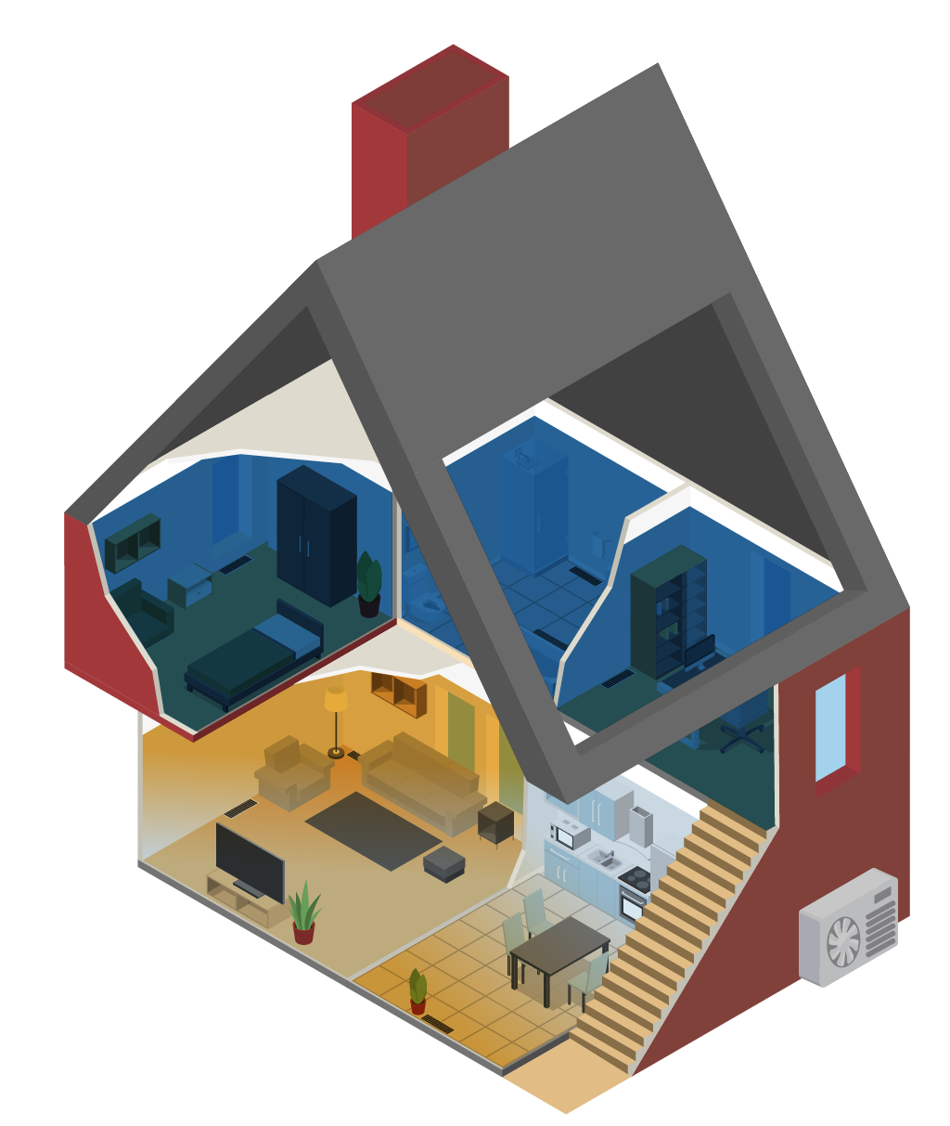
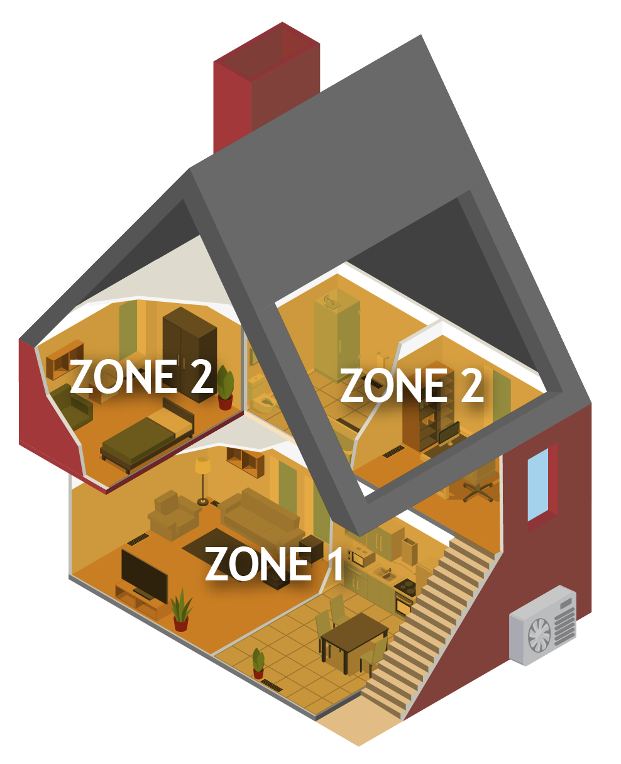
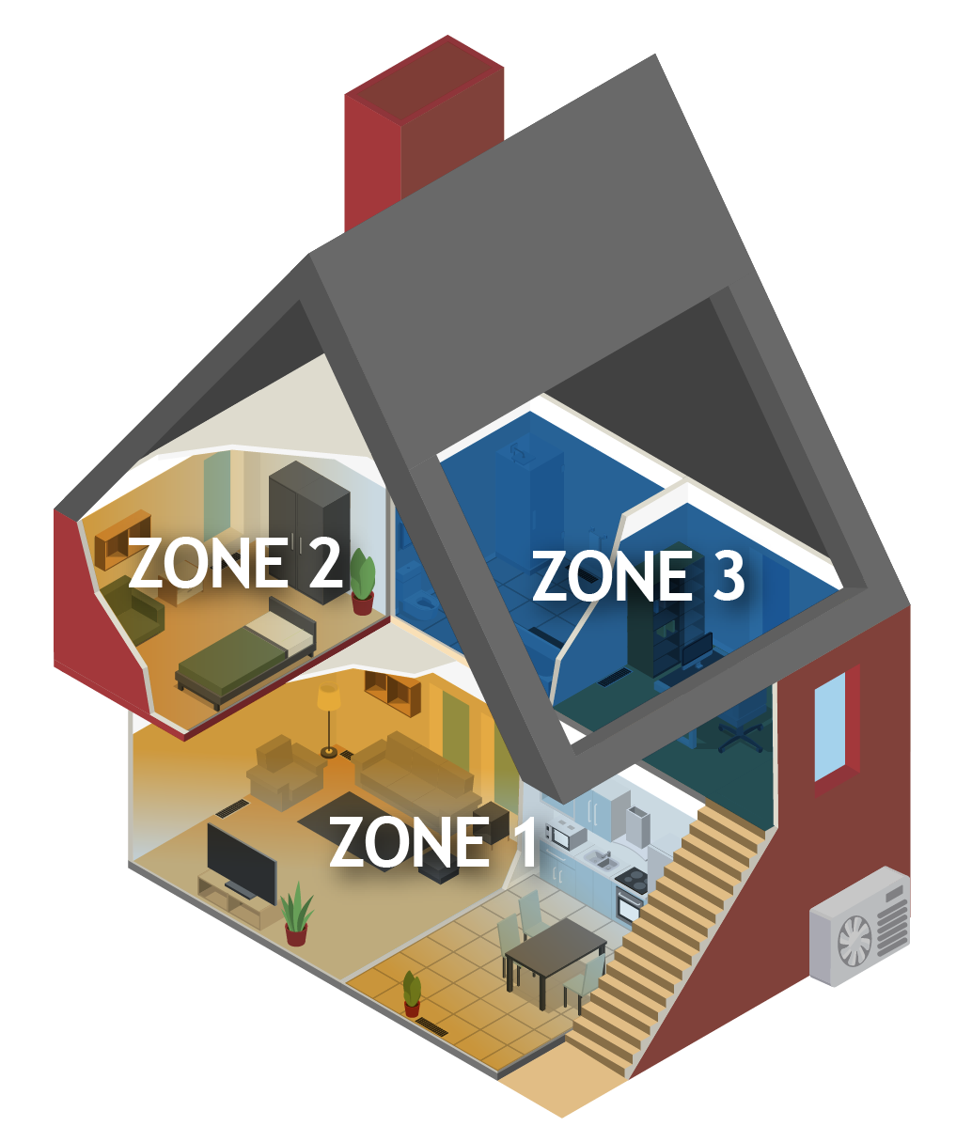
Other Considerations for Performing Load Calculations
Single Zone
Zonal
Whole Home (block)
Partial Load
Notes:
Partial vs. whole load.
Zonal vs. central
Backup supply
From admin deck:
The heat pump(s) can serve a single zone or cover multiple zones.
They can also be sized for whole-home coverage of the full heat load or just partial-load coverage of specific areas.
In partial load scenarios, it is necessary to plan for supplemental heat for the rest of the house (next slide)

Slide 28
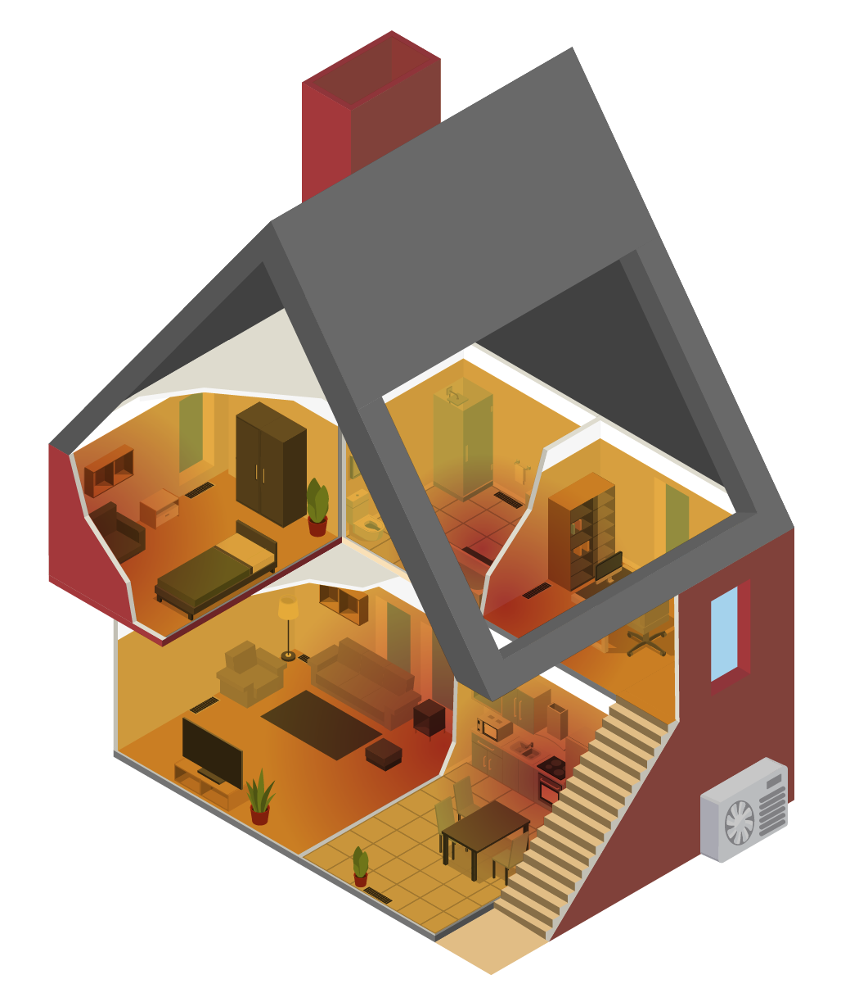
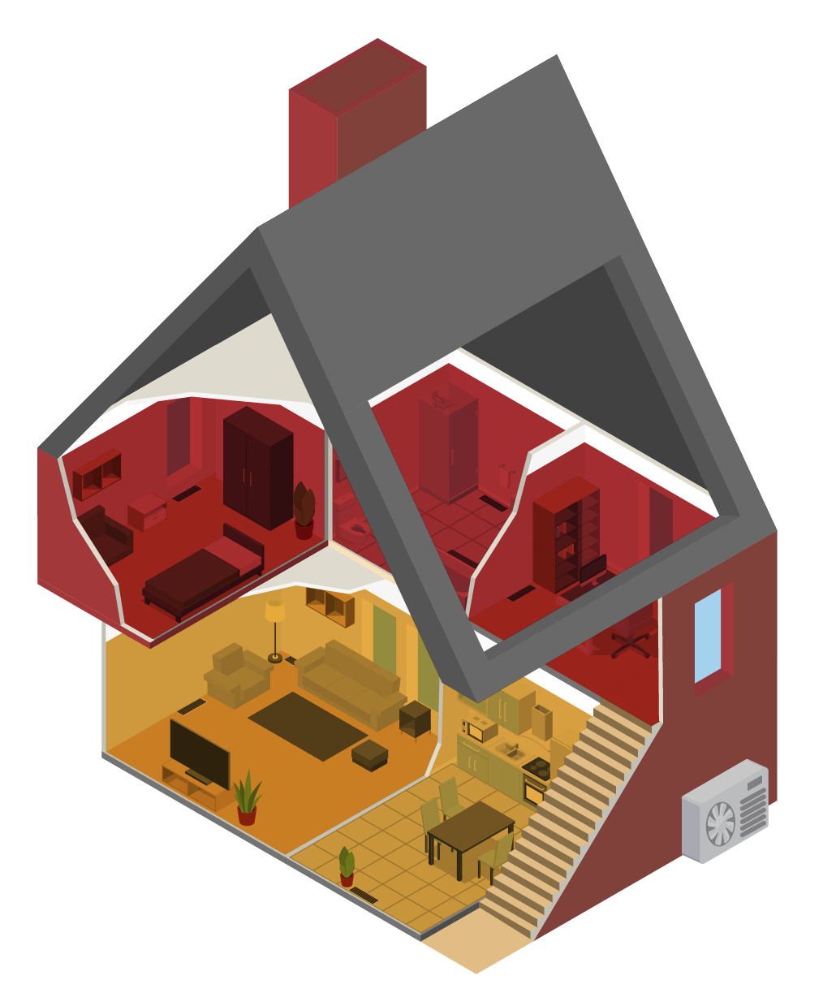
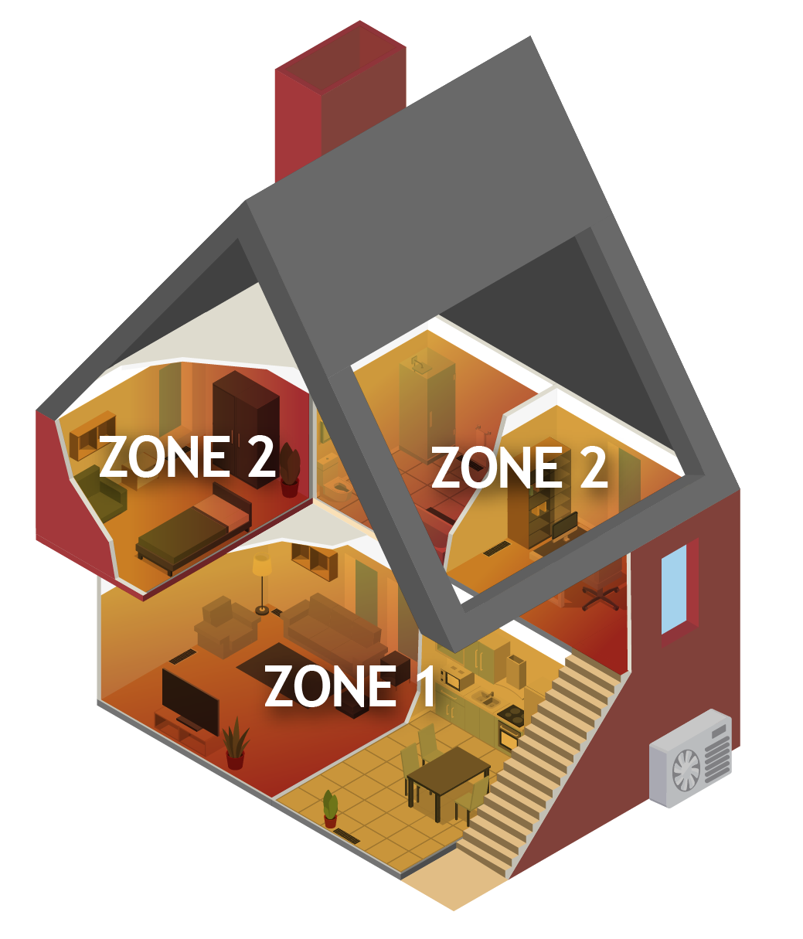
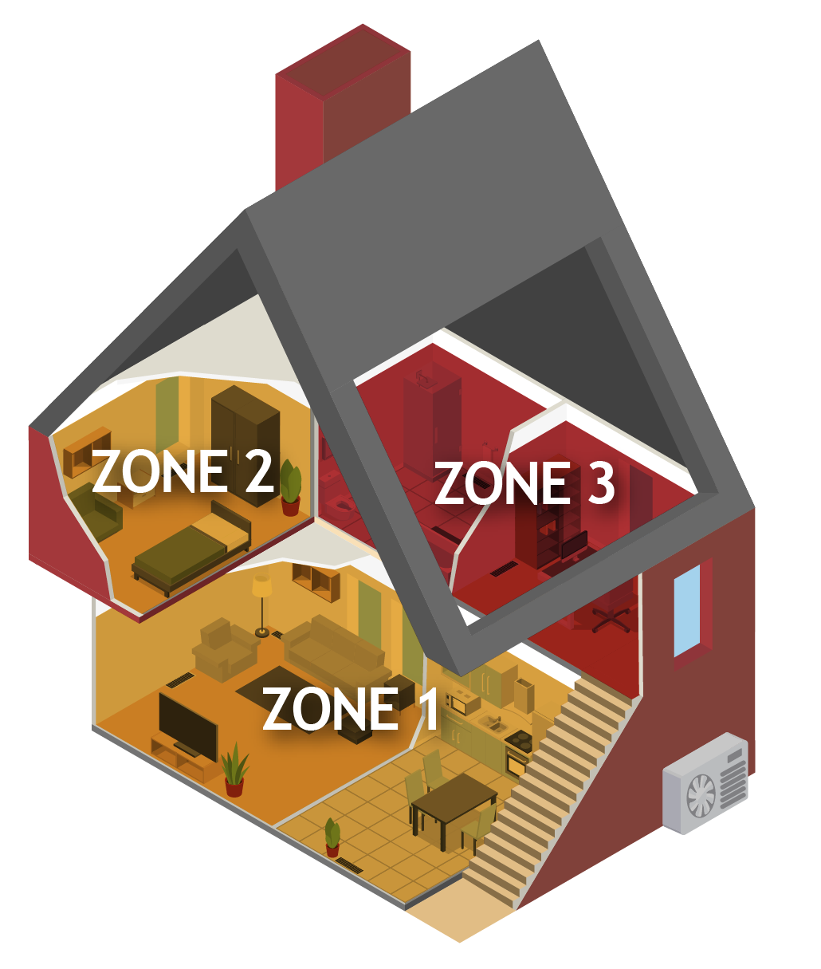
Back-up and Supplemental Heat
Back up
Supplemental
Notes:
Back up heat refers to a secondary heating system designed to provide heating to the entire home in case the primary heat pump system is either out of service, or unable to keep up with the current load
Supplemental heat refers to a secondary heating system designed to provide heating for portion of the house not covered by the primary heat pump heating system.

Slide 29
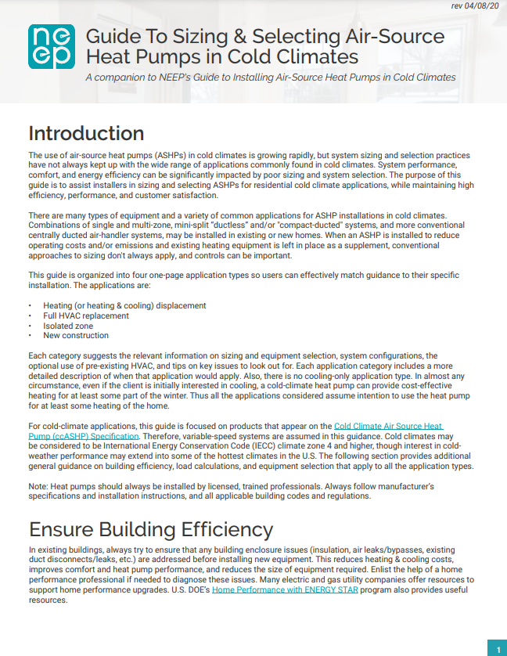
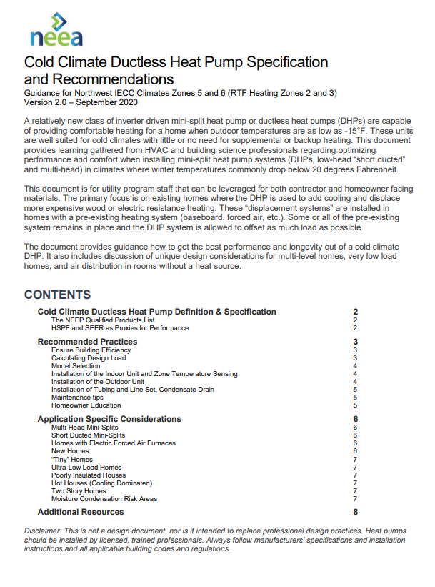
Available Resources Recommended Design Practices
https://neep.org/sites/default/files/resources/ASHP%20Sizing%20%26%20Selecting%20-%208x11_edits.pdf
https://neea.org/img/documents/NEEA-Cold-Climate-DHP-Spec-and-Recommendations.pdf
Notes:
There are several well developed, industry vetted, and easy to follow recommended/best practices available on the market!
NEEP, the Minnesota ASHP Collaborative, NEEA, and heat pump manufacturers have all produced documents and guidance to help contractors design and select equipment correctly to ensure the performance that homeowners expect.

Slide 30
INTERACTION TIME! Performance in New York State
Remote Delivery
Complete the phrase – “standard air-source heat pumps do not work here because ____________”
Complete the phrase – “properly-sized ccASHPs can deliver the following in my area _____________”
In-person
Solicit a standard ASHP “horror story” (like the big bill) from the group
Ask the group to identify how this is avoided with modern ccASHP systems and proper design

Slide 31
Part 3 System Sizing and Specification

Slide 32
System Sizing and Specification Learning Outcomes
Understand the primary goals of an ASHP installation
Learn how proper sizing meets design goals
Understand key design considerations for mini-split and multi-zone ASHP systems
Notes:
Discuss why this is important to the audience. Cater to the specific audience’s roll and pre-knowledge.
Homeowner’s perspective
Contractor’s perspective
Providing enough heating, where it is needed is essential in any heating specification. Having too much heat, can also lead to comfort, cost, and durability problems as the heat pump short-cycles.

Slide 33
What Really Matters When Sizing For Heating
Meeting home heating load on the coldest day
Not providing too much heat on mild days
Delivering heat to every room; choose the right product for the home’s need
Notes:
Sizing a heat pump forces you to consider many, sometimes competing, goals for comfort and cost. These are the 3 most relevant energy/comfort related considerations

Slide 34
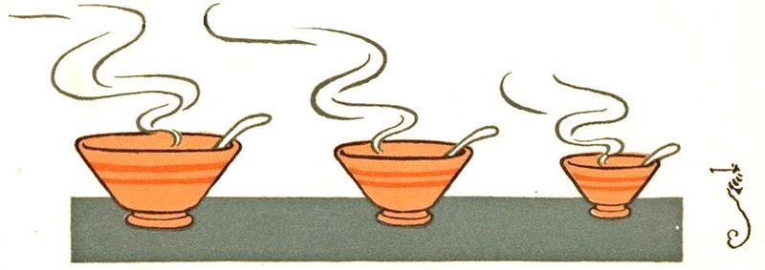



The Goldilocks Principle
Too Small
System will not keep the house warm on the coldest days
Poor comfort, or need for backup heat
Slow catch up if using thermostat setbacks
Too Big
System will cycle on and off
Poor comfort
Poor energy efficiency
Poor durability
More expensive
Just Right
Comfort
Efficiency
Durability
Notes:
Too small can be ok if there’s backup or supplemental heat, with integrated controls. Too big will always lead to shot-cycling problems (turning on and off rapidly, see next slide)
Central image courtesy Wikimedia Commons; Adapted from Denslow's three bears (W.W. Denslow, 1903) by user Theornamentalist; Free from copyright

Slide 35
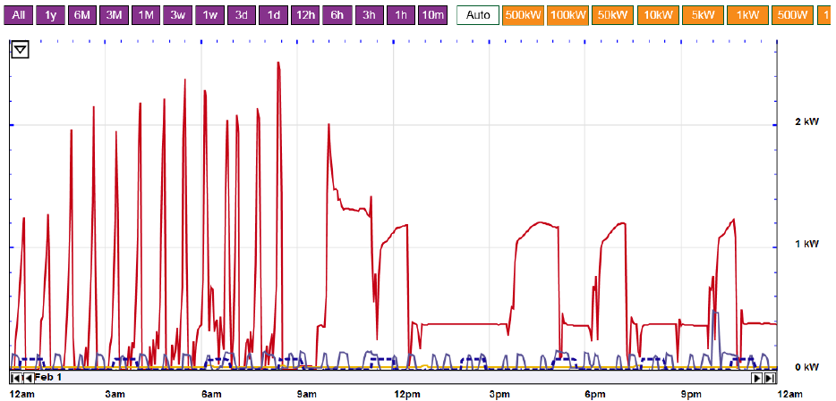
Too Much Heat Leads to Short Cycling
Short cycling: turns on and off repeatedly
Right-sized: runs for 20 min. to 2 hour blocks steadily
Notes:
Short-cycling is when the heat pump turns on and off frequently and repeatedly. This typically occurs because it is oversized for the current condition. Before it is fully fired up, it has fulfilled the home’s needs. This is inefficient operation.
The charts show the heat-pumps input power over time. You can see the heat pump turn off and turn on rapidly on the left. On the right, it runs in a few steady long stretches.

Slide 36

Heat Pump Selection and Sizing
Goal #1: Meeting home heating load on the coldest day
Equipment Candidate
Max Output (Btu/hr)
21,400 at 7°F
31,743 at 7°F
40,850 at 7°F
Design Load = 28,450 at 7°F
Notes:
Example Process:
Load Calculation shows 28,450 BTU/hr at design temp (7°F)
Look up extended performance tables of potential units (from the NEEP database or manufacturer’s listings)
Confirm the selected heat pump provides 90-125% at 7°F

Slide 37
Heat Pump Selection and Sizing
Goal #2: Not providing too much heat on mild days
Equipment Candidate
Max Output (Btu/hr)
Min Output
(Btu/hr)
28,600 at 7°F
16,600 at 47°F
31,743 at 7°F
12,780 at 47°F
32,900 at 7°F
7,460 at 47°F
Design Load = 28,450 at 7°F
Load at 47°F = 4,740 Btu/hr
Notes:
Example Process:
Load calculation shows 11,650 BTU/hr at 47°F
Look up extended performance tables of potential units (from the NEEP database or manufacturer’s listings)
Confirm the selected heat pump provides 90-125% at 7°F
Also known as the turn-down ratio, though this term can be misinterpreted. Conceptually it the maximum output over the minimum output. How much can the unit turn-down and produce small amounts of heat when you do not need as much.
Note: The second system is probably ok. It may over-cycle a bit, but it is close enough.

Slide 38
Heat Pump Selection and Sizing
Goal #3: Choose the right product for your need
Energy efficiency
Heating – Heating Seasonal Performance Factor (HSPF): >10 is preferred
Cooling – Seasonal Energy Efficiency Rating (SEER): >15 is preferred
Manufacturer’s extended performance data has higher granularity of efficiency ratings that can help optimize the decision
Other features/functions
Automation and controls
Integrated back-up heat
Noise rating
Price – higher efficiency tends to be more expensive

Slide 39
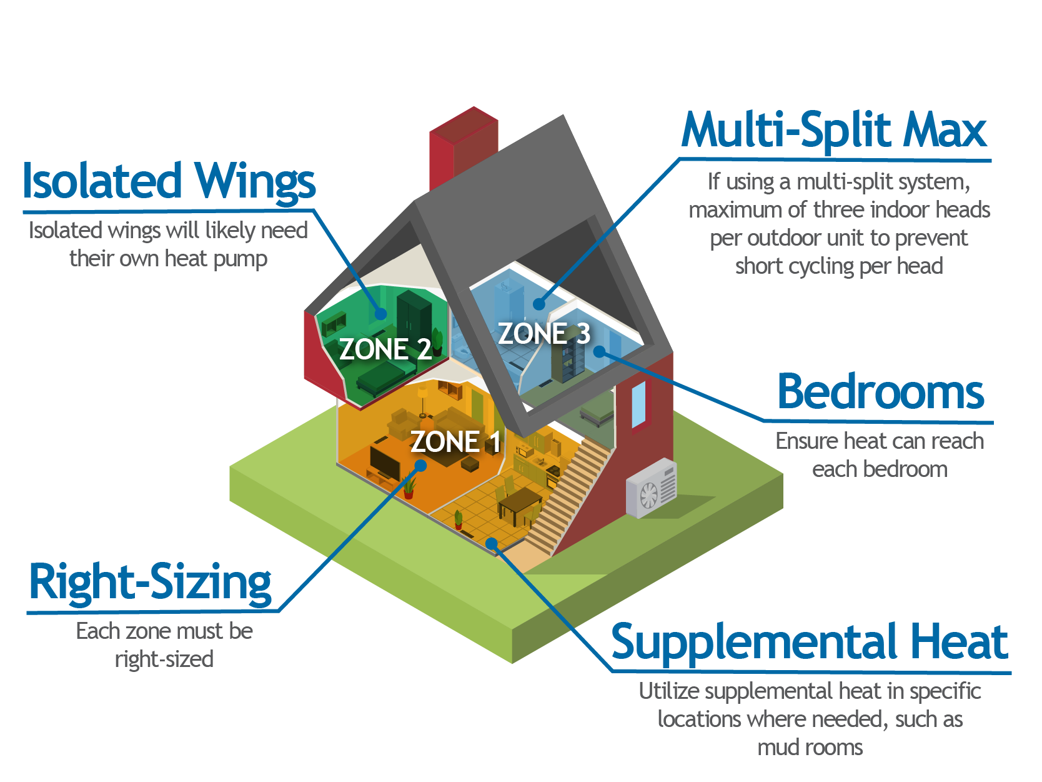
Heat Pump Selection and Sizing Multi-Zone or Multi-Split Design

Slide 40
Part 4 System Design Options and Considerations

Slide 41
System Design Options Learning Outcomes
Understand the different ASHP designs and their intentions
Learn different design options for ASHPs by home need
Understand key considerations for system design
Notes:
Discuss why this is important to the audience. Cater to the specific audience’s roll and pre-knowledge.
Homeowner’s perspective
Contractor’s perspective
There are many ways, and many considerations in how to best distribute heat around the home. These decisions are the drivers for comfort and cost.

Slide 42
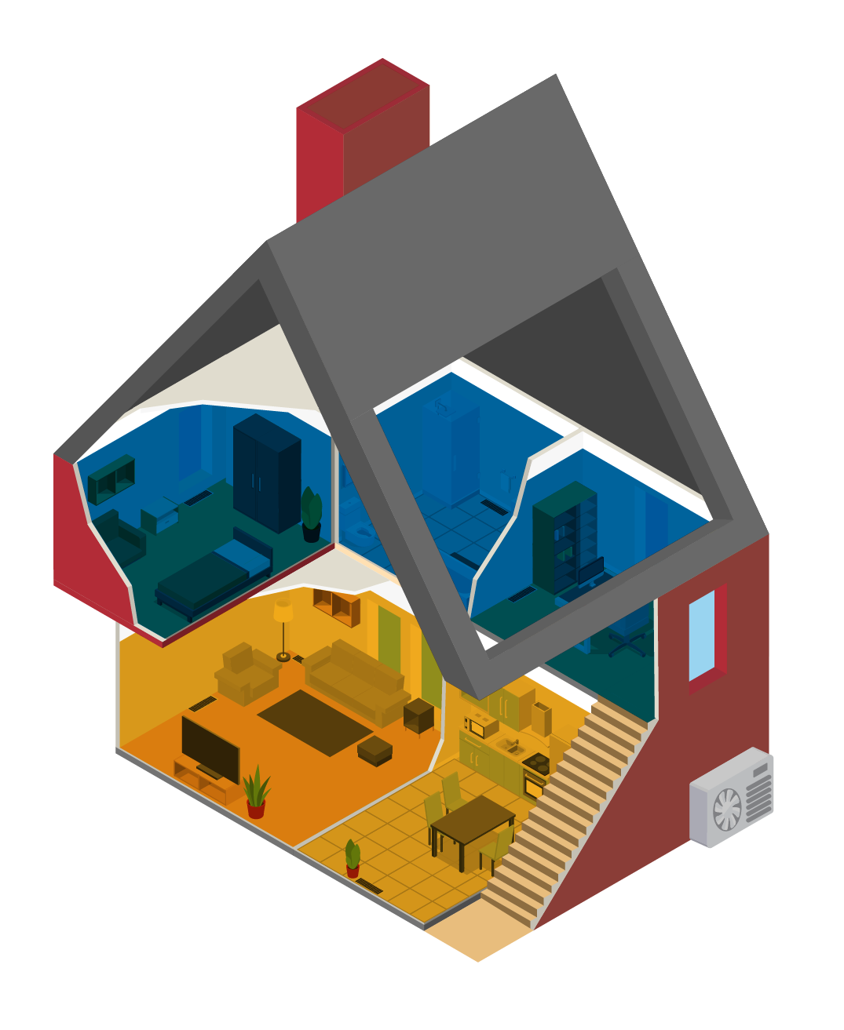
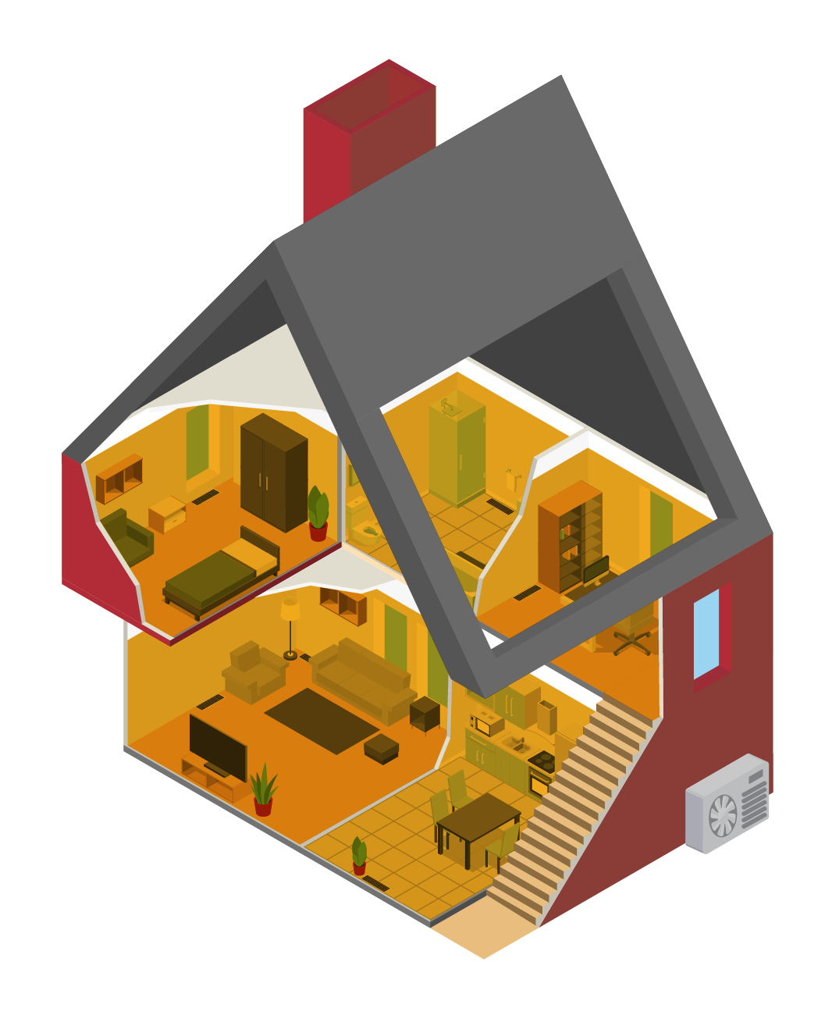
Design Intention #1 Displacement vs. Replacement
Only heat a portion of the home
Only serve a portion of the load
Leave or create supplemental heat
Heat the entire home at full load
Backup is optional
Displacement
(Partial Load)
Replacement
(Full Load)
Notes:
Displacement = Partial Load Replacement = Full load

Slide 43
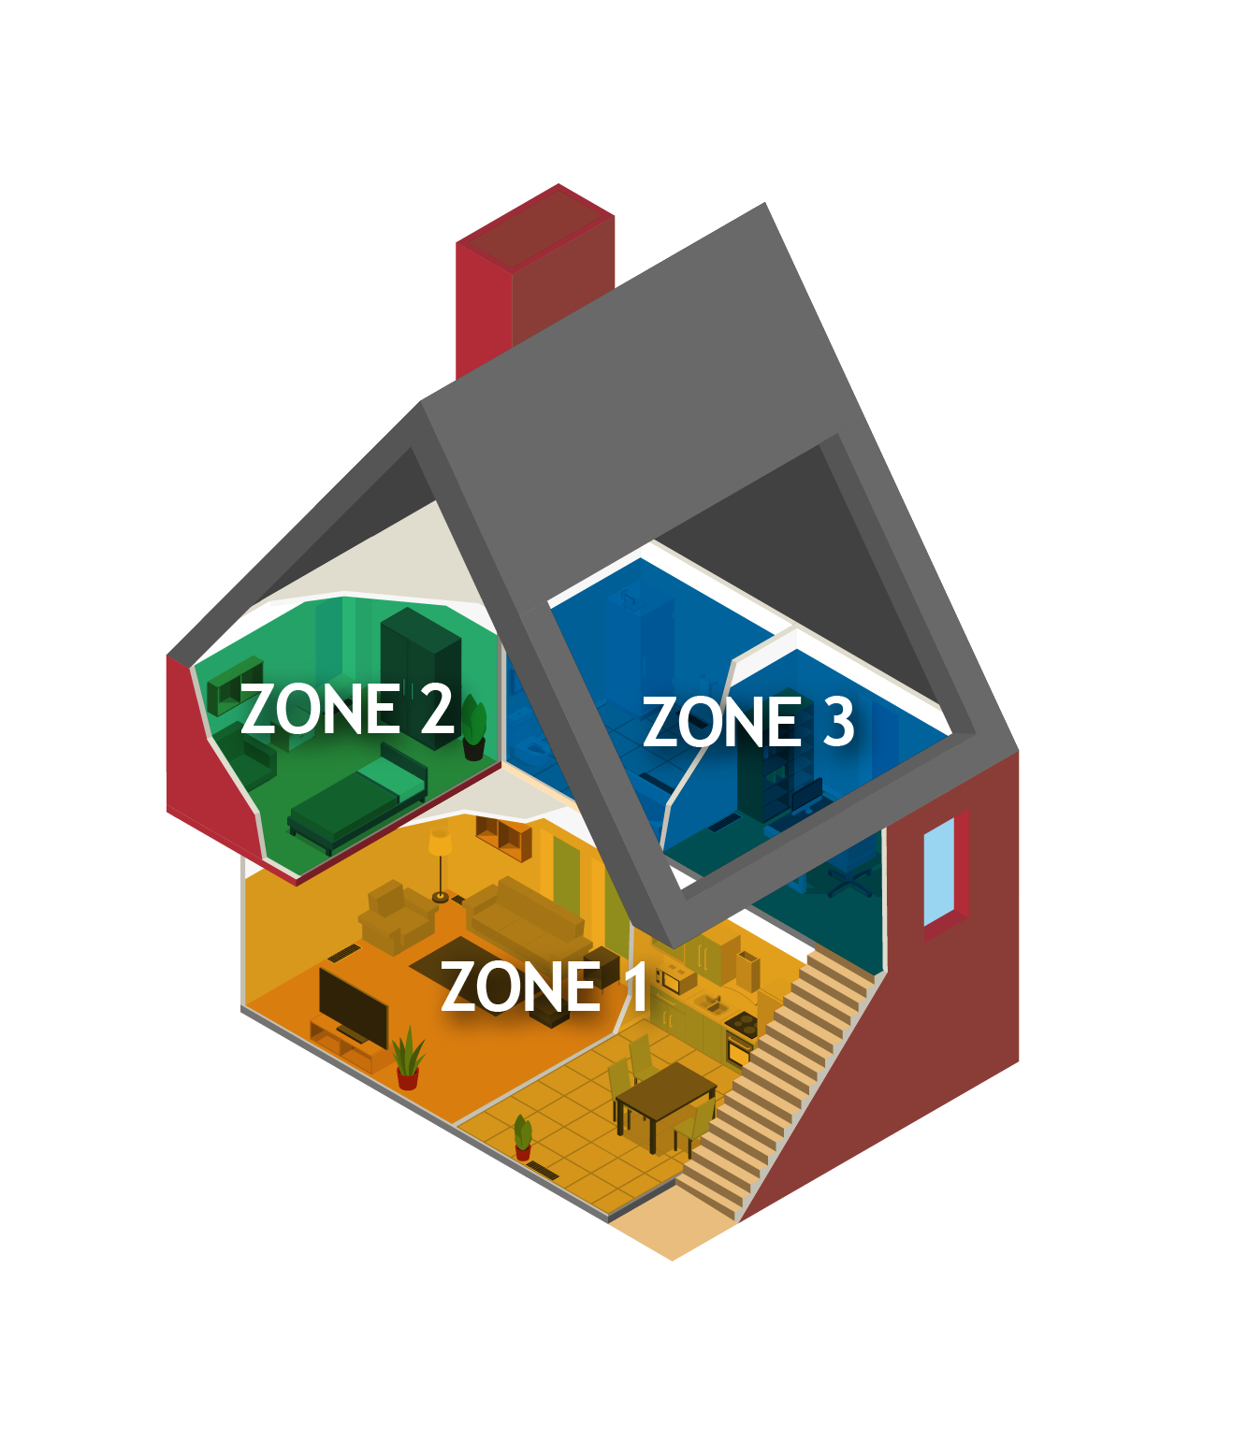
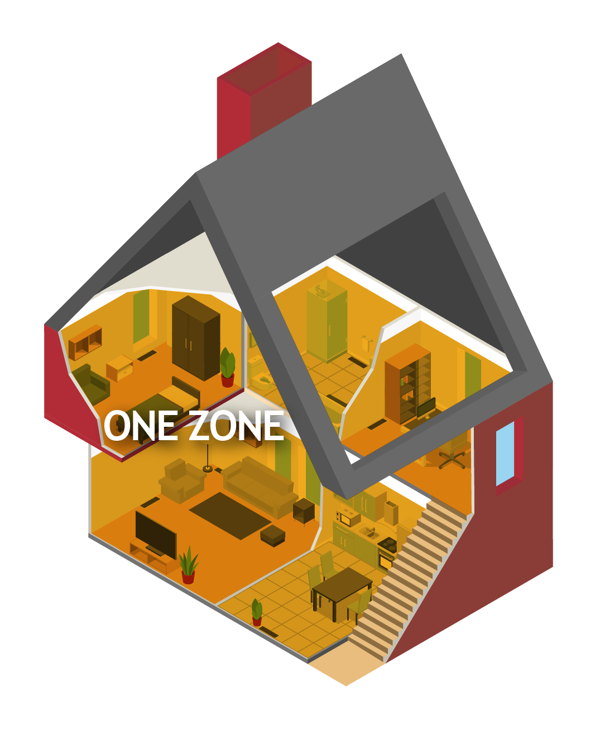
Design Intention #2 Zonal vs. Whole Home
The home is split into zones, each with its own heating
Each zone has its own thermostat and controls
Best for larger homes
Best for complicated layout
One thermostat controls the entire home
Best for smaller homes of simple geometry
Best with ducted systems
Zonal
Whole Home

Slide 44
Design Options Ducted vs. Ductless
Heat is distributed to each room through ducts
Best for replacement/full load scenarios
Individual heat pump heads in strategic locations
Best for displacement/partial load
Best in simple home layouts
Ducted
Ductless
Notes:
Both can be zonal. Both can serve either replacement/full load or displacement/partial load. The home’s specific geometry and layout, plus the nature of existing systems in a retrofit will drive the decision.

Slide 45
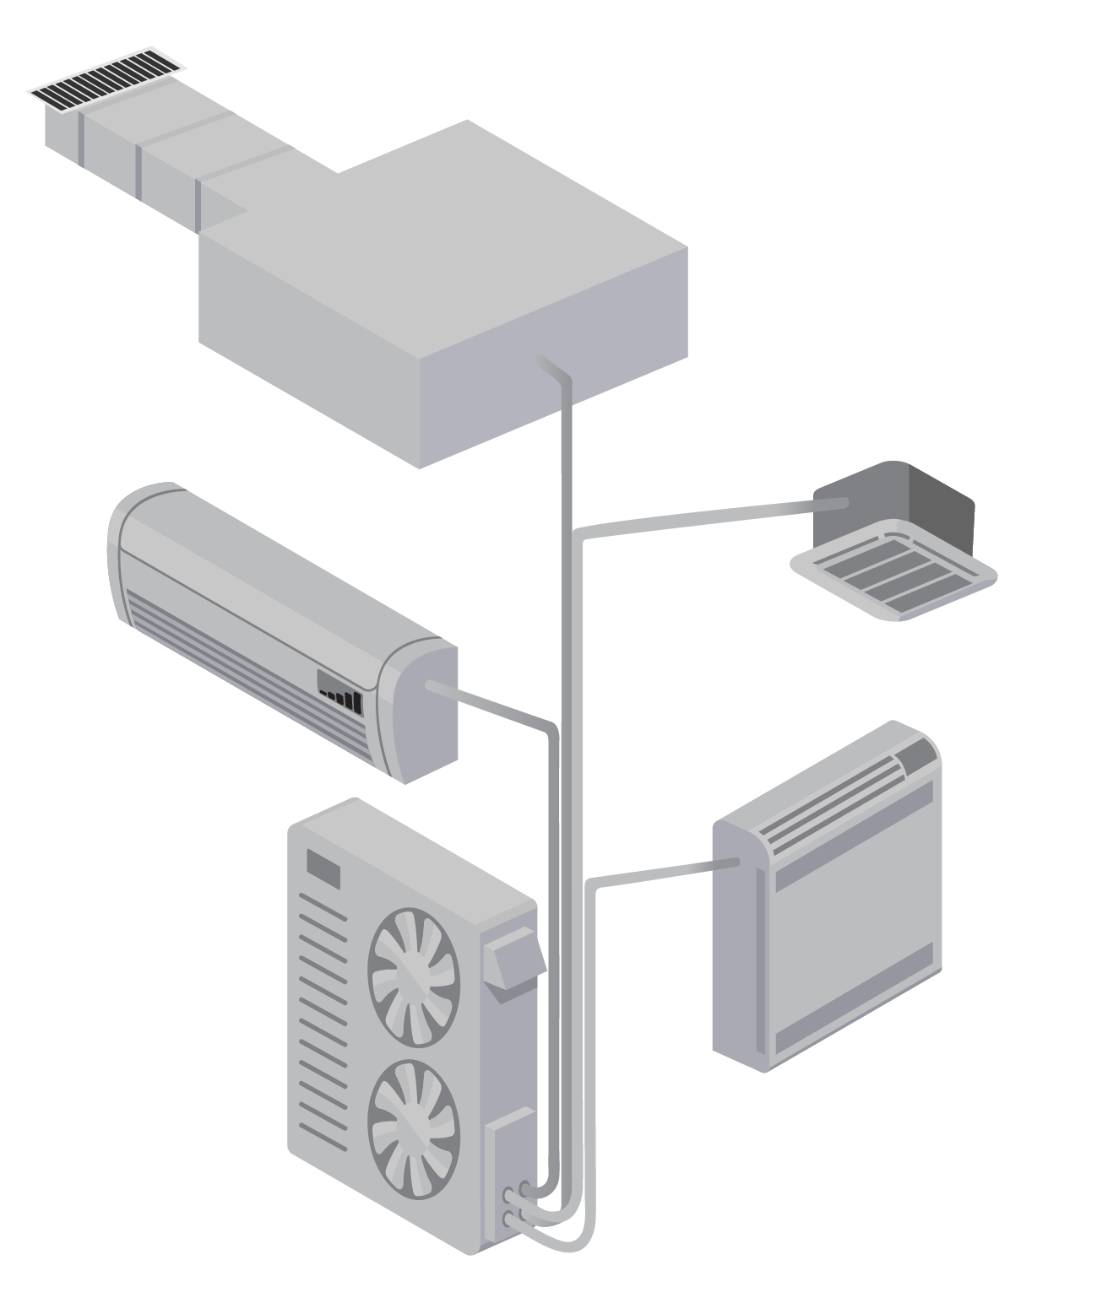
Ductless Design Options Mini-Split vs. Multi-Split
One head per outdoor unit
One thermostat
Can install multiple mini-splits in a home
Multiple heads per outdoor unit
Each head is controlled by its own thermostat
Requires careful sizing and zonal considerations
Mini-split
Multi-split
Notes:
Technically, a mini-split may have multiple indoor heads, but they are all controlled by a single thermostat.

Slide 46
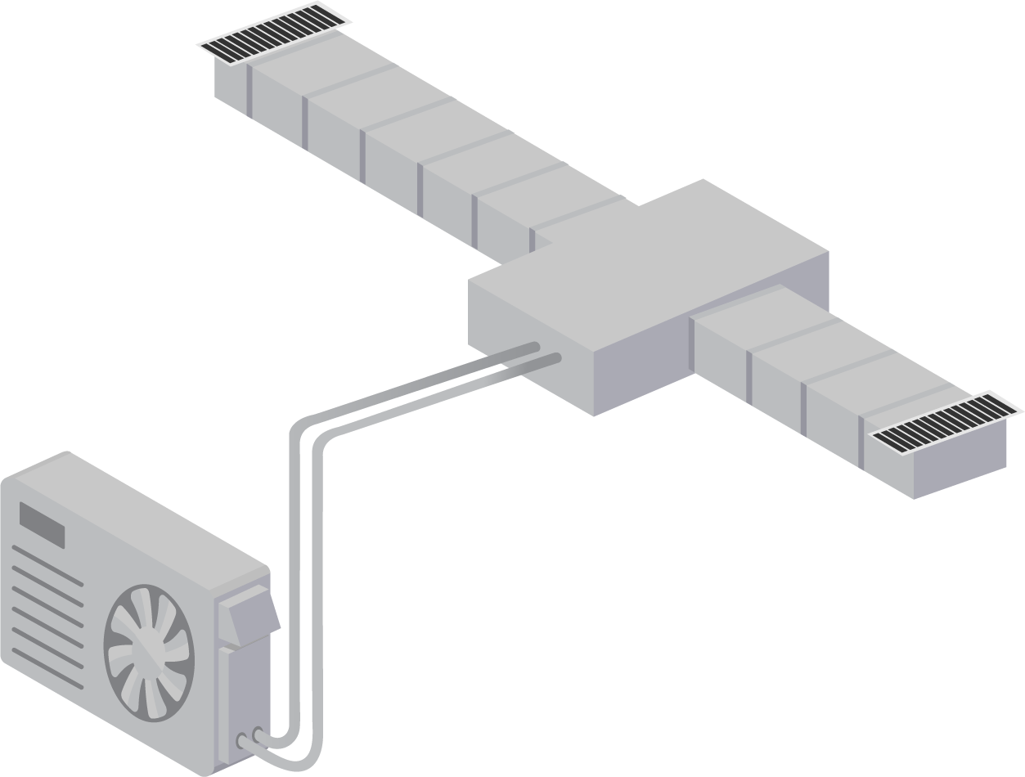
Other Design Options Compact Ducted and Combination
Short duct runs, 15 feet or less
Useful for closely located smaller rooms (bedrooms, office, etc.)
Ducted in some zones, ductless in others
Example: 1st story vs. 2nd story
Example: Master suite vs. rest of house
Can improve load matching
Compact Ducted
Combination
Notes:
Unlike traditional heating systems where you typically have one single large heating plant (furnace or boiler), whose heat is then distributed throughout the house in ducts or hydronic loops, heat pumps solutions can be very modular and creative. Customized to the space and need.

Slide 47
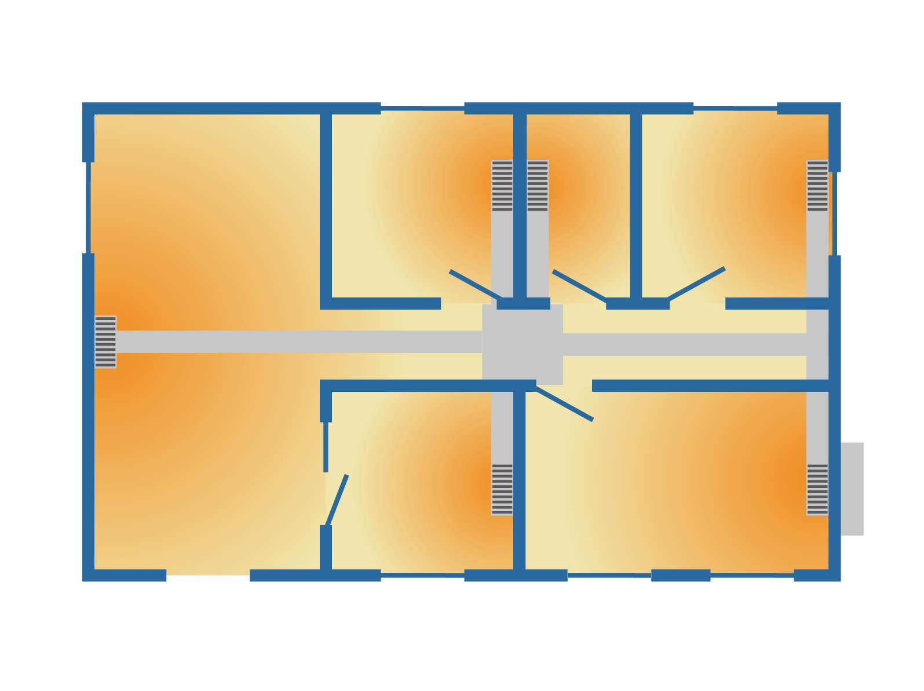
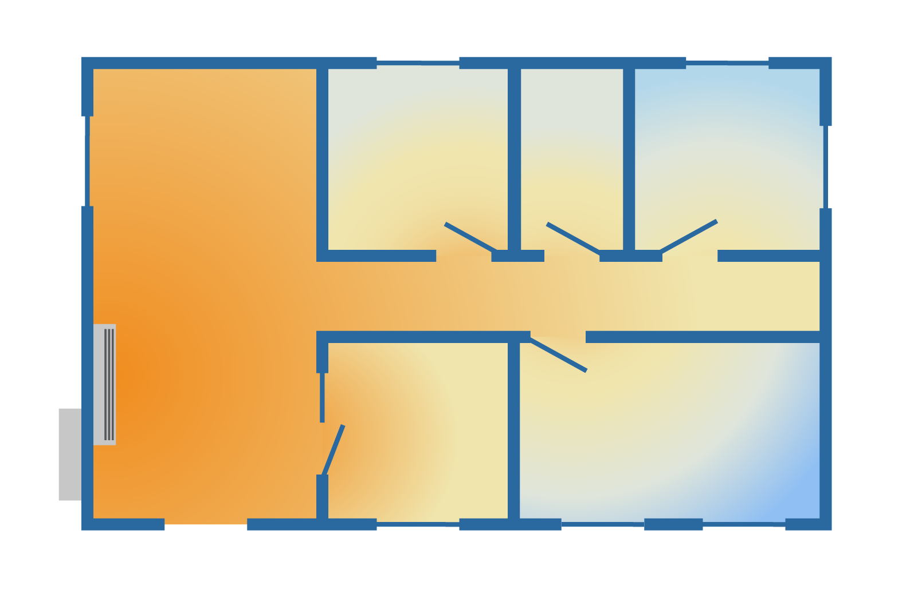
Other Design Considerations Indoor Layout
Location of supply and return grilles
Location of ducts
Location of heat pump and air-handler unit
Running ducts to multiple floors
Location of thermostat
Ducted
Location of heads, relative to walls and doors
Style of heads – wall sconce, floor-mounted, in-ceiling
Optimizing flow of conditioned air to reach as much of the home as possible
Location of thermostat
Ductless
Notes:
(instructor notes): Walk through each image. Discuss the challenge of getting heat to each room in a ductless scenario. Some rooms will be cold and need their own heat pump head or a supplemental heating source. Some codes require each bedroom to have its own heating source (duct supply, indoor head, or other)

Slide 48
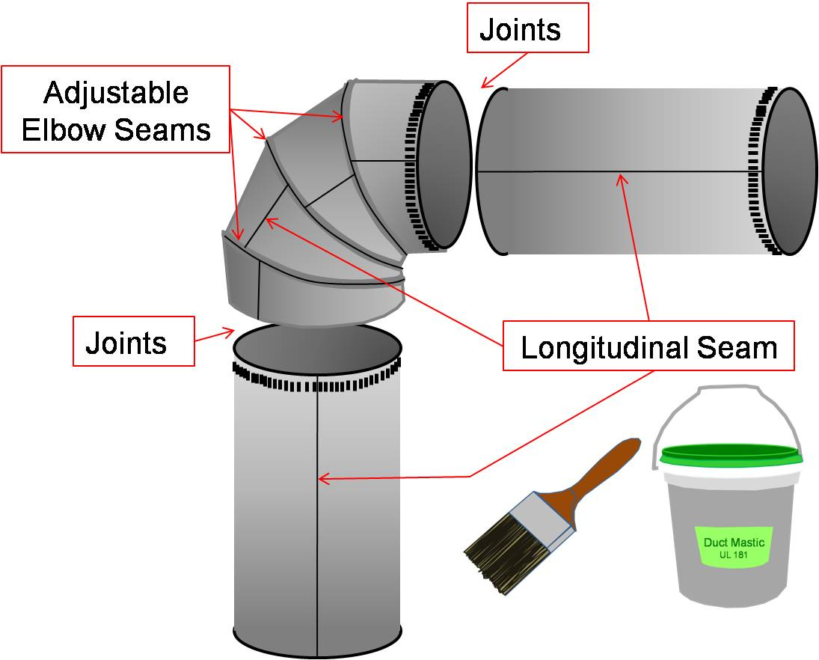
Other Design Considerations Duct Design
Use and follow ACCA Manual D
Design for sufficient airflow through the ducts
Duct sizing
Static pressure
Minimize sharp bends
Use turning vanes, even on return drops
Place ducts in conditioned space when possible
Air seal all ducts
Use mastic, aluminum tape (UL 181), or gaskets
Test for leakage
Insulate all ducts in unconditioned, or partially conditioned spaces
R-8 or greater preferred
Buried or deeply buried in insulation
Best practice to insulate ducts even in conditioned space
Notes:
Duct design is a whole topic in and of itself that requires education and thoughtful application. Duct tape is not actually designed for ducts and should never be used. The adhesive fails easily under heat stress.
Duct Sealing image coure

Slide 49
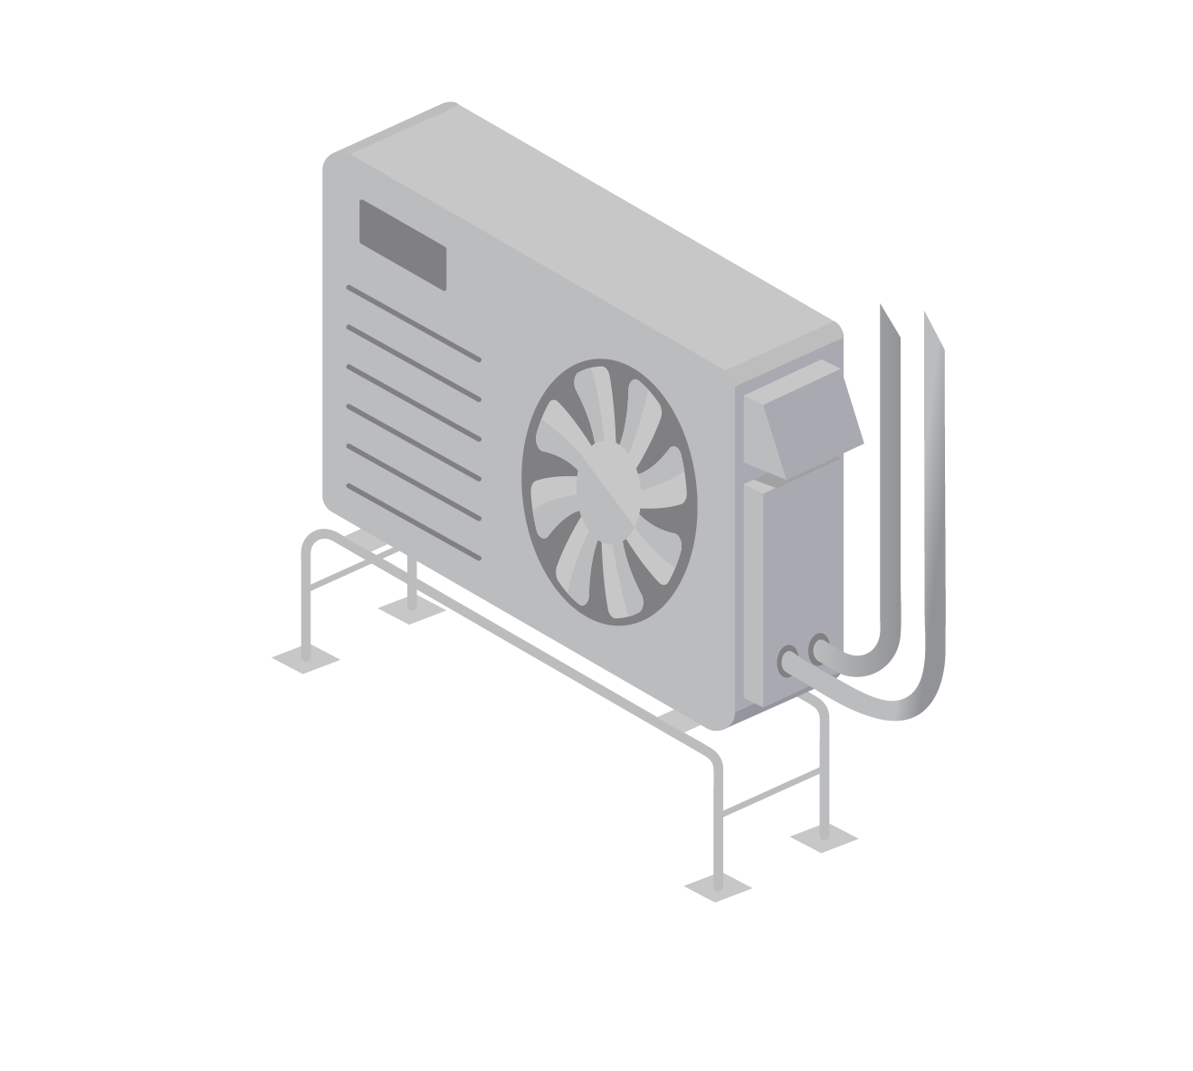
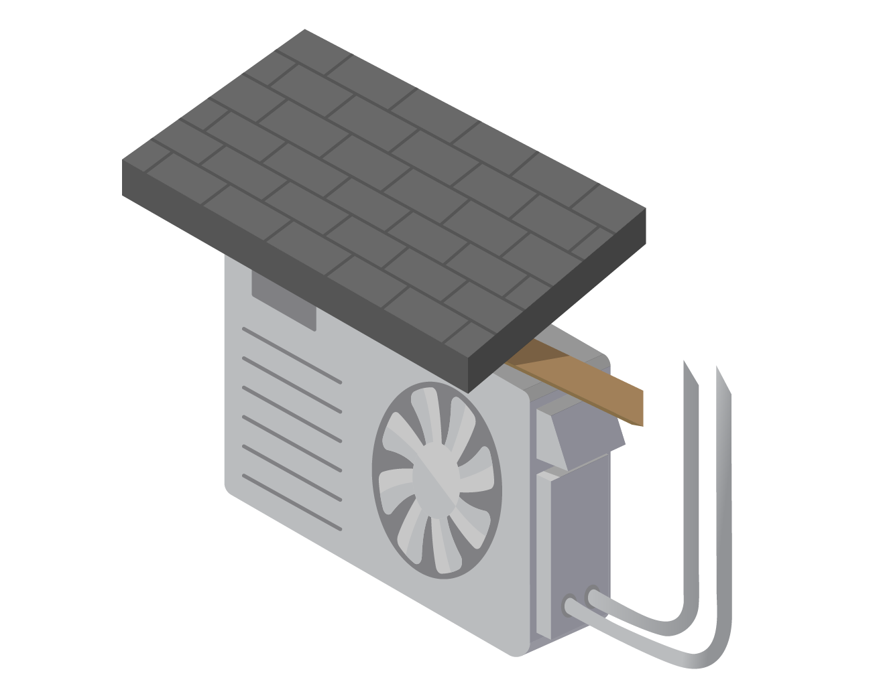
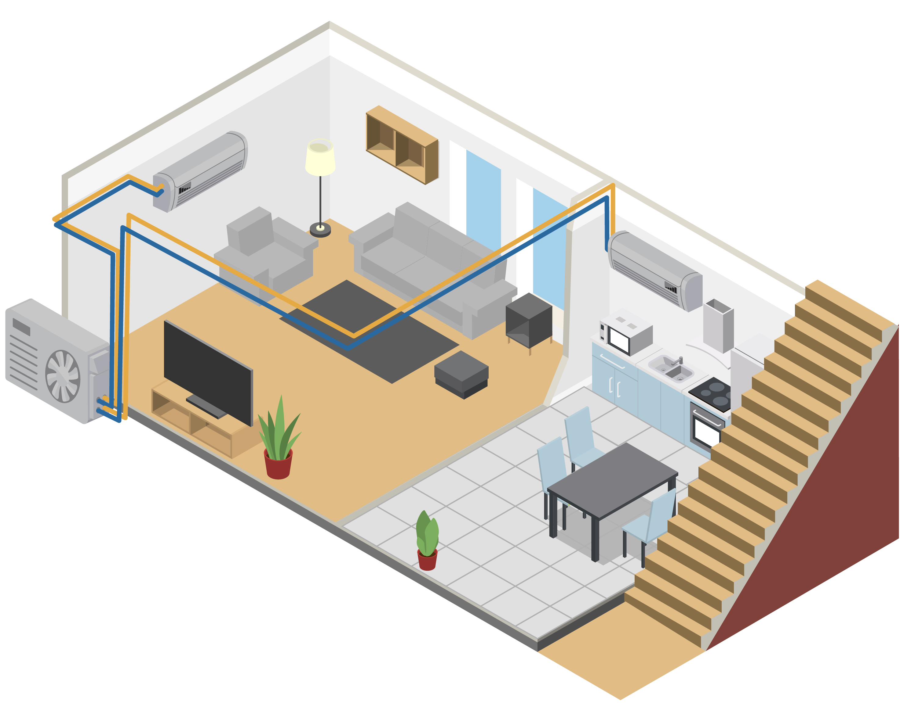
Other Design Considerations Outdoor Unit
Snow protection—off the ground on risers (preferred) or wall-mounted
Place on gable ends of the home to avoid roof-dump
Wind (leaves and similar) protection—do not place in corners with wind-eddies
Condensate drain planning—ensure water has somewhere to drip that avoids freezing, walkways, and on top of other outdoor condensers
Defrost drip planning
Lineset considerations:
Can the refrigerant line easily reach the indoor unit?
Can the refrigerant line be kept short (≤ 25 feet ideally)?
Noise/vibration concerns
Nuisance and animal protection
Notes:
Wall mount is less desirable due to noise/vibration issues. Risers is the better method.

Slide 50
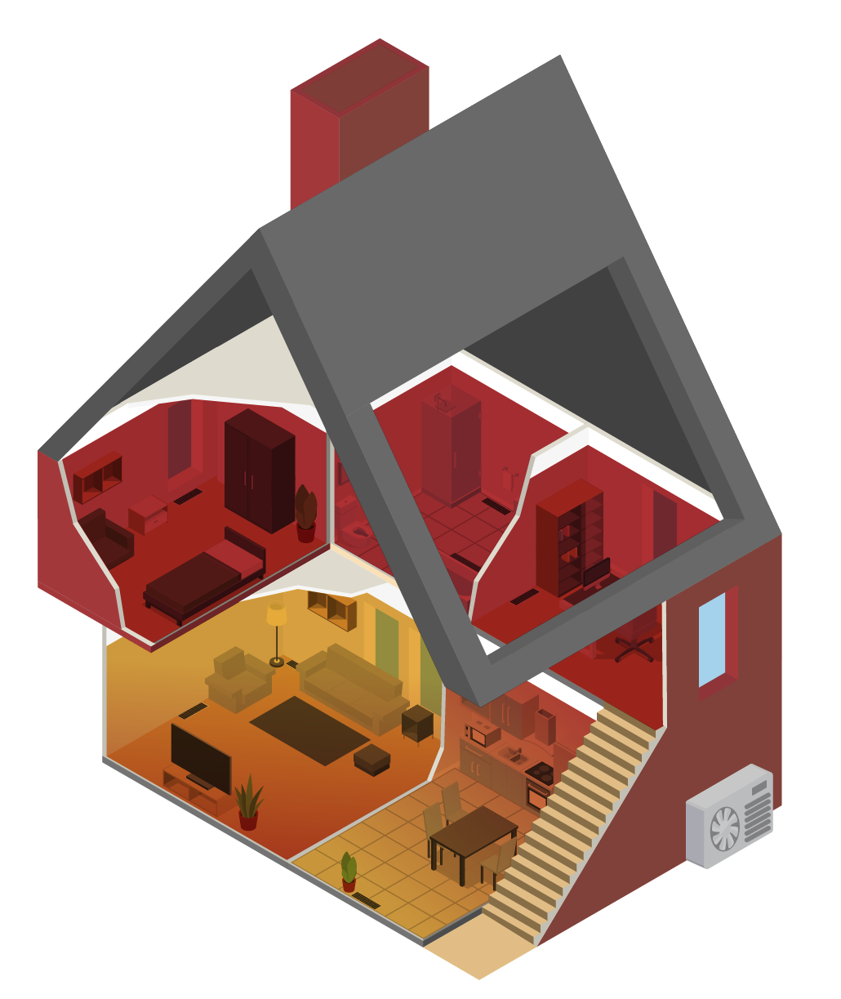
Other Design Considerations Backup vs. Supplemental Heat
Backup
Must cover nearly the whole home and the whole home’s load
Critical to include primary living area and water pipe locations
Can be gas, oil or electric resistance based
Intended to run infrequently—thermostat settings and controls must be integrated
Supplemental
Covers the portions of the home not served by heat pumps
Intended to run frequently—thermostat locations and settings must be integrated

Slide 51

Design Decision Methods Identify Customer’s Needs
Interest/willingness for doing load reduction measures first
Desire to stop using fossil fuels
Occupancy patterns (long spells away from home vs. consistently occupied)
Do they want cooling throughout the house or just in certain rooms?
Cost concerns
First cost vs. ongoing fuel and maintenance costs
Plans for renovations or additions
Notes:
Reduce the load first! If renovations or additions are planned in the near future, typically wait for those before installing a new heating system (if possible) so that load reductions can occur at that time, and so that sizing the final long-term heating system is accurate to the home at that point.

Slide 52
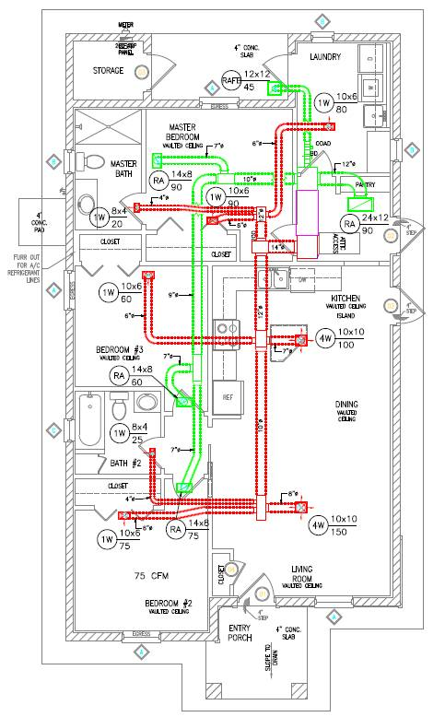
Design Decision Methods Identify Current Home Heating and Layout
Does the home already have ducts?
Can they be repurposed or kept in place for a backup/supplemental system?
Is the home’s current heating already zoned?
What is the expected functional life of the current heating system?
Does the home have electric resistance heat anywhere?
Does the home’s layout include multiple floors or isolated wings?
Is the home’s main living area open-concept for free movement of conditioned air?
Are there constraints on where to place the outdoor unit, such as a close neighbor?
Is there sufficient space and power capacity in the breaker panel?
Are there opportunities for load reductions first?
Notes:
Image courtesy of Building America Solution Center

Slide 53
Part 5 Thermostats and Controls

Slide 54
Thermostats and Controls Learning Outcomes
Understand common ASHP control types
Learn about integrated control strategies for back up or supplemental heat
Understand control principles
Learn about temperature setback nuances specific to ccASHPs
Notes:
Discuss why this is important to the audience. Cater to the specific audience’s roll and pre-knowledge.
Homeowner’s perspective
Contractor’s perspective
The best system only functions as intended if properly controlled.

Slide 55
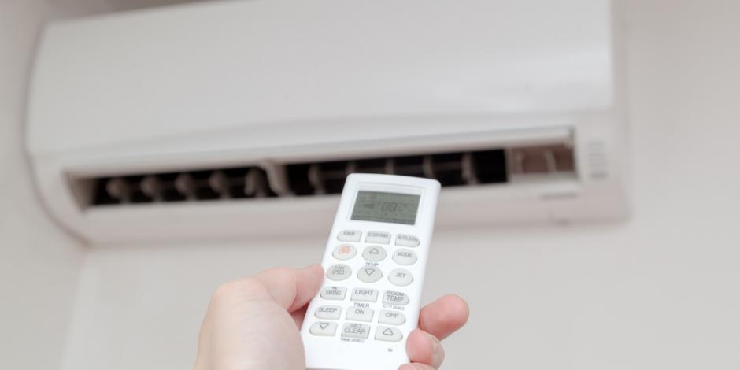



Controlling the Heat Pump
Ductless Wand/Remote
Wall Thermostat
Mobile App
Smart Wall Thermostat
Notes:
Typically, most DHPs will come with a “wand” style controller that almost looks like a remote control. This is only a controller, the thermostat itself is typically a part of the wall or ceiling indoor unit.
Many manufacturers also sell wall mounted thermostat style controllers. Depending on the brand, you may need additional components or simply understand the control settings in the thermostat in order to get the wall unit to also act as the thermostat – temperature detectors.
In addition, some of the top manufacturers also have Apps that can be used to control systems, providing flexibility for homeowners. Be sure to check with your manufacturer or distributor rep to learn if additional components, optional features/specific models are needed for these apps to work.
Finally, a few DHP manufacturers also have their own “smart thermostats” that work similar to Nest and Ecobee, but may not apply to all product lines that they offer.

Slide 56
Controlling the Backup Heat
Integrated controls
One thermostat controls both the heat pump and the backup
Gives primacy to the heat pump when economical
Balance point programmed for automatic changeover at 5°F to 35°F depending on system capabilities
Simultaneous operation (aka droop method) —backup system’s heating setpoint 3°F colder
Separate controls
Backup thermostat location similar to heat pump’s
Droop method—backup system’s heating setpoint 3°F colder
Notes:
Many systems offer control over balance-point and backup activation though thermostat control or from programing the unit “board” (i.e., using menus or dip switches). Clear guidance should be provided to installers regarding thermostat and unit configurations and a commissioning checklist should be developed for each thermostat / equipment combination. The most careful equipment selection and design can be undone

Slide 57
Controlling the Supplemental Heat
Separate controls
Supplemental thermostat located in the supplemental zone
May be viable for a small droop—2°F—to maximize heat pump use on mild days

Slide 58

Control Principles
Different than traditional heating
Avoid deep-daily setbacks—(max 3°F at any time-step)
Reduce reversion to catch-up mode
Deep setbacks for vacation are fine
Be careful when pairing with 3rd party thermostats (Nest, Ecobee, etc.)
The heat pump’s control algorithms can conflict with the 3rd party tool.
Use the Efficiency operating mode (different manufacturers use different terms)
But beware of reversion to factory default after a power-outage
Monitor the energy use for unexpected patterns or behaviors
Notes:
During catch up mode, the heat pump uses a high-gear for high-output, but at significant cost to efficiency during that mode. Often it can use up more energy during catchup than it saved during a setback period. See next slide.

Slide 59

Setback Norms Difference
Daily setback 4 – 7°F
Vacation setback 7 – 15°
High heat comes on to recover
Great savings from reduced heating during the setback
Daily set back 1 – 3°F
Vacation setback 7 – 15°
Compressor operates at steady speed to recover
Recovery can take longer than with traditional systems
Good savings from reduced heating during the setback, without recovery penalty
Gas/Oil
Heat Pumps
Notes:
When a VCHP tries to catch up a large temperature difference, it will either operate at aggressive, inefficient speeds, or it will trigger electric resistance back up heat (also inefficient). Any savings accrued during the setback can easily be eaten up during inefficient recovery period. For long periods of time (>1 day) a deep setback still saves energy.
Upon return, the home will take longer to catch up than what a gas/oil system would provide. Consider triggering the start of recovery by a timer, or a mobile app ~6-10 hours early if viable.

Slide 60
Part 6 Recommended Practices and Design Examples

Slide 61
Recommended Design Practices Learning Outcomes
Understand recommended practices for ccASHP design
Apply learning to home design examples
Notes:
Discuss why this is important to the audience. Cater to the specific audience’s roll and pre-knowledge.
Homeowner’s perspective
Contractor’s perspective
This section puts the whole package together with practical applications layering what was learned in previous sections on load calculations, sizing, design considerations, and controls.

Slide 62
Recommended Practices Sizing Process
Determine customer’s preferences
Assess current heating system and home layout
Conduct load calculations; whole home (block load) and/or zonal
Determine properly sized heat pump
Determine optimal system design
Integrate with backup and/or supplemental heating
Set up controls
Install as per specification
Goldilocks principle
Load served
Equipment locations
Ducts/Ductless
Commission (test) the system
Notes:
The middle row, steps 4, 5 and 6, all occur concurrently to some degree, informing each other. If you know you are going to use supplemental heat, you will choose a differently sized heat pump and a different design setup.

Slide 63
Recommended Practices
Conduct building takeoffs/ site-survey
Get load calculations right
No extraneous safety factors
Represent actual conditions
Use the specified indoor and outdoor design conditions
Leverage the NEEP Cold Climate Air-Source Heat Pump Product List
Ensure outdoor and indoor units are identified as compatible in the AHRI database
Determine if displacement/partial load or replacement/full load
Size for each zone – max. at design conditions, min. at 47°F
For multi-splits, max of 3 indoor heads per compressor
Load Calculations
System Sizing Selection
Notes:
Traditionally, HVAC trades are more concerned with under-sizing a system than oversizing. It is common to include safety factors, or consistently apply “worse case” assumptions that drive towards a higher load calculation than is the reality. Cold climate heat pumps, due to their ability to modulate need to be sized relative to precise load calculations.

Slide 64
Recommended Practices
Place in the top third of the wall for standard heads
Up to 6 inches from the ceiling
When possible, place where there’s at least 20 feet of clearance in front of the unit for best air mixing
Middle of the room, not corners
Consider the need to deliver heat to each room
Ensure ducts are adequately sized, Manual D is recommended
Specify sealing existing ducts in crawl spaces, attics, and garages
Design new ducts to minimize friction losses (i.e., use large radius bends or turning vanes)
Avoid specifying new ducts into outside conditioned space whenever possible
Indoor Heat Location
Ducting
Notes:
Indoor head location is all about ensuring proper circulation of conditioned air across as much of the house as possible. Too close to the ceiling or blocked by a wall will impede air mixing.

Slide 65
Recommended Practices
Design and select locations with enough room for free air flow
Minimize refrigerant line lengths
Specify risers or mount to wall above typical snow line
Specify install locations to not be under or near bedroom windows
Avoid installations under condensate drip lines
Design for drain to slope downhill
Design so that terminations are not near walkways or into crawl spaces
Specify external condensate pump when needed
Ensure condensate line will drain without being blocked by frozen condensate
Outdoor Unit
Condensate
Notes:
Wall mounted units should be discouraged due to vibration impacts. Ground-mounting on risers is preferred.

Slide 66

Design Example #1 Single Story, Simple Layout
Current heating is single-zone radiant baseboard heat from a boiler
Home is poorly insulated and air-sealed
Inputs
Design Solution
Displacement scenario; single ductless head in the living room
Maintain existing system to provide supplemental heat in the far bedrooms
Move supplemental thermostat to master bedroom
Consider second head in master bedroom
Notes:
Encourage discussion, or volunteers to answer the design question before revealing the suggested solutions. Multiple solutions may be viable.

Slide 67
Design Example #1b Single Story, Simple Layout
Current heating is an old, ducted natural gas furnace near end of its life
Ducts are in poor repair. Home is well insulated and air sealed
Inputs
Design Solution
Replacement scenario; leverage existing ducts for new ducted ASHP
Reseal and insulate ducts and confirm/update duct design as needed
Remove existing furnace, do not install backup heat
Notes:
Encourage discussion, or volunteers to answer the design question before revealing the suggested solutions. Multiple solutions may be viable.

Slide 68

Design Example #2 Two Story
Inputs
Design Solution
Current heating is an intact hydronic radiant baseboard system using an oil boiler
Homeowners are first-cost sensitive, but want to reduce their carbon footprint
Home is moderately insulated and air sealed
Displacement scenario; ductless system serving 1st floor living area
Retain existing heating system as supplemental for upstairs, backup for downstairs
Notes:
Encourage discussion, or volunteers to answer the design question before revealing the suggested solutions. Multiple solutions may be viable.

Slide 69
Design Example #2b Two Story
Inputs
Design Solution
Current heating is an old forced air with poorly maintained ducts
Master bedroom is frequently cold and physically isolated from rest of house
Homeowner is first-cost focused and cannot currently afford a full-house system
Displacement scenario; multi-split ductless zonal system serving living area and master bedroom
Retain existing heating system as supplemental for Zone 3, backup for master and downstairs
Notes:
Encourage discussion to answer the design question before revealing the suggested solutions. Multiple solutions may be viable.
The retained supplemental heat can eventually ultimately be replaced by a ccASHP.

Slide 70
Common Design Failures
HVAC contractors use rules of thumb derived from gas or oil systems. Heat pumps short cycle at mild temperatures, hurting energy performance.
Oversized systems
Backup continues to provide most of the heating
One-solution-fits-all thinking
Sub-optimal indoor head location
Poorly integrated control schemes or unclear homeowner education can lead to the backup heat doing most of the work.
A contractor gets comfortable with a specific system, (e.g., 2 head ductless multi-split) and attempts to apply it to all homes.
Contractors are least familiar with point-source heating and air mixing. Indoor heads are placed where they are blocked (mixing), too close to the ceiling, or unable to provide adequate heat for closed-door bedrooms or offices.
Notes:
Encourage discussion on these and other design issues seen by the audience.

Slide 71
INTERACTION TIME! The Customer
Remote Delivery
Pick a standard customer (via poll)
Participants pick top features for the customer (via poll)
In-person
Group activity
Each group creates a selling proposition for a specific customer:
Electric baseboard heating and window air conditioning
Oil boiler only
Central forced-air heating and cooling
Each group reports out 2-3 key reasons
Notes:
Pick 3 out of 7 features. Talk about why they were ranked as they were.
Now show 7 benefits. Anyone not want to sell these?

Slide 72
Lessons Learned
Variable capacity heat pumps operate differently than traditional heating systems, and so need a different design approach
Load calculations are critical for proper sizing; more so even than traditional heating system types
Sizing affects comfort, performance, efficiency, and durability
Design decisions and integrating with supplemental heat require careful consideration of the home’s layout and homeowner’s needs
Controls schemes must consider integration with backup or supplemental heat systems

Slide 73
Thank You!

Slide 74
Appendix A: Abbreviations and Acronyms
Abbreviation | Definition
ACCA | Air Conditioning Contractors of America
AHRI | Air Conditioning, Heating, and Refrigeration Institute
ASHP | Air source heat pump
BTU/hr | British thermal unit per hour
ccASHP | Cold climate air source heat pump
ccDHP | Cold climate ductless heat pump
COP | Coefficient of performance (instantaneous efficiency rating)
ECM | Electronically commutated motor
HSPF | Heating seasonal performance factor (heating efficiency rating)
HVAC | Heating, ventilation and air conditioning
NEEA | Northwest Energy Efficiency Alliance
NEEP | Northeast Energy Efficiency Partnership
SEER | Seasonal energy efficiency ratio (cooling efficiency rating)
VCHP | Variable capacity heat pump

Slide 75
Appendix B: Resources Links
NEEP’s ccASHP Specification and Product List
NEEP’s Guide To Sizing & Selecting Air-Source Heat Pumps in Cold Climates
NEEA’s ccDHP Sizing Recommendations

